Slide 1

EYFS
St John’s Catholic Primary School, Trowbridge

Slide 2
What a wonderful start!

Slide 3
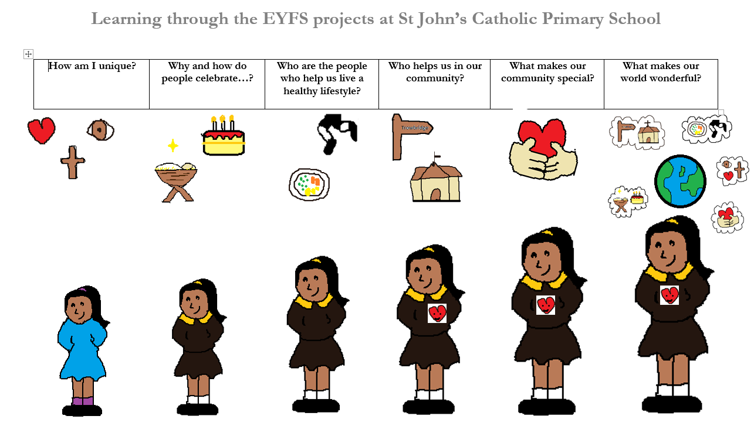
Share visual Learning Story

Slide 4
Full time attendance
Timetable
PE –Monday afternoons and Thursday mornings
Forest Friday – Friday mornings

Slide 5
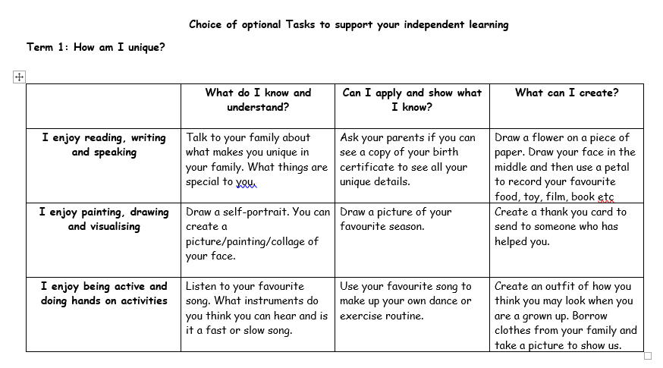
Your Contribution….
Attendance
Read with your child daily
If possible complete the home learning projects termly and send in any work to celebrate!
Offer your experiences and/or knowledge of others countries, traditions, faiths, areas of work or any other area of expertise!
Support us by sending in photos to support the topics

Slide 6
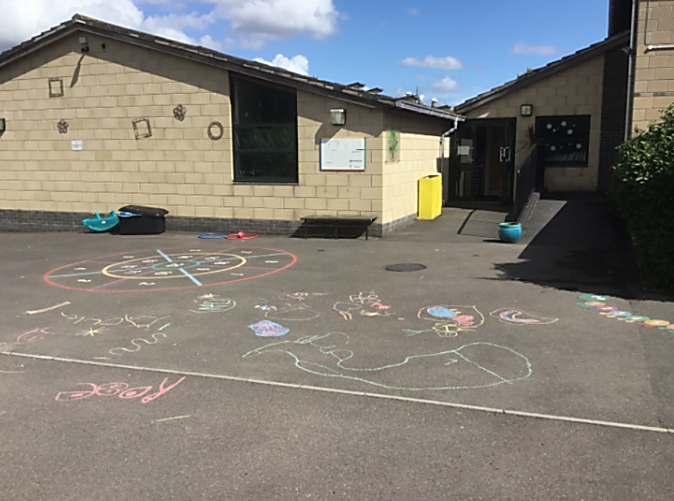
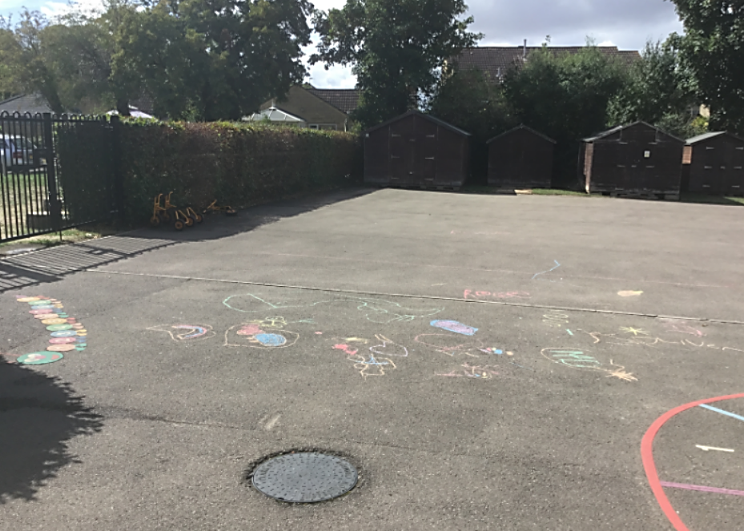
Pick up and Drop off
8.40am - 8.45am Drop off at black gates
3.15pm - Pick up – gates will open a few minutes before 3.15pm please come on to the FS Playground but when waiting please stay behind the grey concrete line running along the playground. Gates will be shut at 3.30pm
Blue circle shows area to wait in
Please stand behind the grey concrete line

Slide 7

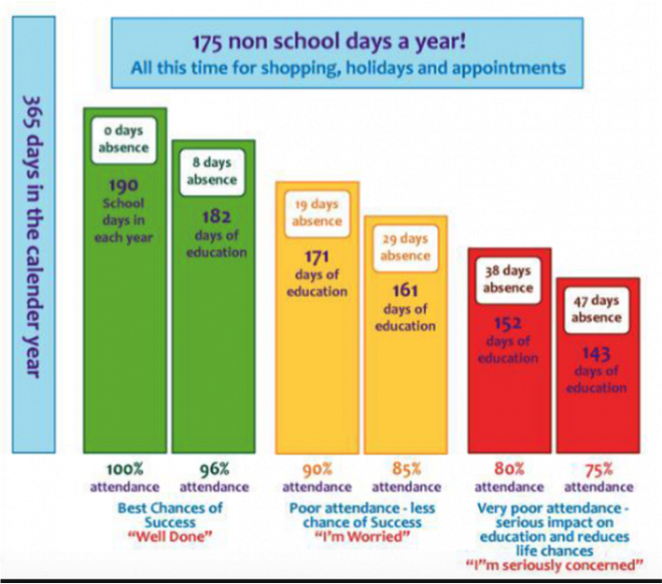
If you would like support with your child’s attendance please contact
Mrs O’Mahony, our Inclusion Lead, via the school office.

Slide 8

School starts at 8.40am.
Children should be on the playground by 8.40am, ready to go into class.
We would like to remind you that if your child arrives late to school, an adult MUST accompany them to the school office and fill in one of these slips.
Late Slip – to be completed by the parent/carer
Name of Child: _______________________Class:___
Date: ___/___/23 Time:_________ Signed: ___________
Reason for being late to school:_____________________

Slide 9
Uniform expectations
Named uniform – even shoes and socks!
Trainers
Welly boots
PE kit
Rain coats
Hair accessories

Slide 10
Coming up…
Thursday 19th September – Phonics workshop 12.15pm – 13.00pm
Friday 20th September – coffee morning
Friday 20th September – Stay and play for 2025-2026 starters 2pm-3pm
Sunday 13th October – children’s Mass 10.30am St John’s Church
Thursday 17th October – 3.30pm – 6.00pm parents evening
Tuesday 22nd October – 3.30pm – 6.00pm parents evening
Thursday 14th November – Welcome Service 9.05am

