Slide 1
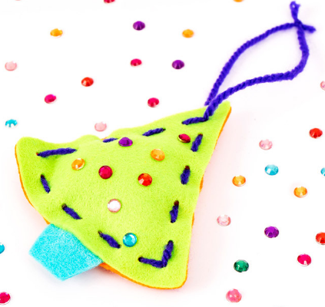


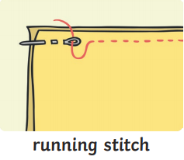
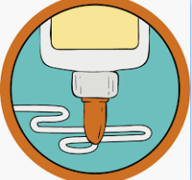
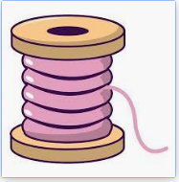
St John’s Catholic Primary School
Catholic Social Teaching: Solidarity and the Common Good
Topic: Why and what do we celebrate | Year group: FS | Focus area: DT - Textiles
What will we use this knowledge to make
Key Vocabulary
Needle
Fabric
Running stitch
Glue
Thread
What I will be able to do
Use a needle and thread with support
Use tools and techniques learnt to join materials they are using
Create a running stitch
Create a Christmas decoration.
Things to Talk About
Have you sewn before?
What do we need to do first?
What stitch are we going to create?
What did you find challenging?
What could you change next time?
Where are you going to put your decoration?

