Slide 1

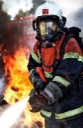
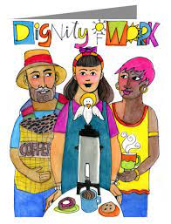
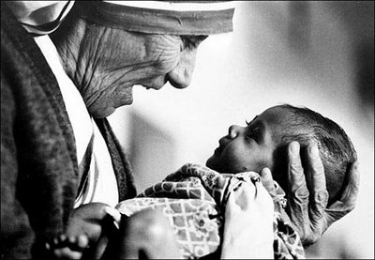
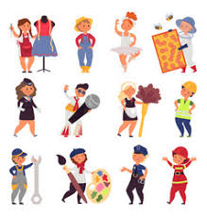
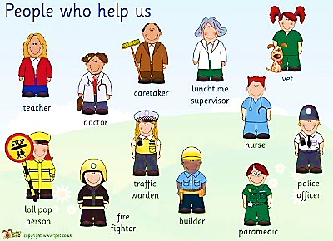

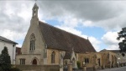
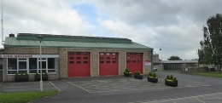
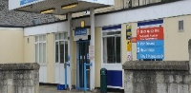
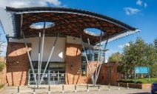
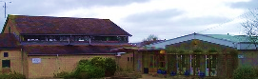

St John’s Catholic Primary School
Catholic Social Teachings: Solidarity of the Common Good and The Dignity of Work
Topic: Who are the People Who Help Us In Our Community? | Year group: EYFS | Focus area: UTW
What will we use this knowledge to do
Show interest in the lives of people who are not familiar to them Made aware of different occupations, life styles and ways of life in our community Visit and talk to a range of professionals Plan and prepare questions
Key Vocabulary
Emergency
Courage
Dignity of Work
Dignity of the Person
Occupation
Things to talk about
Who are the people who help us in our community?
What skills and qualities do people need to be a ….(fire fighter, charity aid worker, medic etc)
What would you like to know more about ways people help in our community?
What should we remember to do in an emergency
What can we all do to help other people?
Occupations:
What I will know
Help/Support – To make it easier for someone to do something
Assistance – help someone to complete something
Emergency – A sudden serious or dangerous event which needs immediate action to deal with it.
Courage – Not showing fear when something is dangerous/scary
Equipment – Items/tools used for a particular purpose
Uniform - The distinctive clothing worn by members of the same organisation
Priest
Key Places:
Trowbridge fire Station
St John’s Catholic church
Trowbridge Police Station
Trowbridge Hospital
Our School

