Slide 1
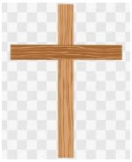
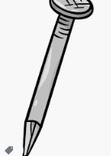


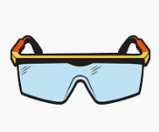
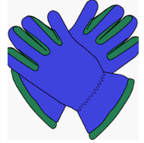
St John’s Catholic Primary School
Catholic Social Teaching: The common good
Topic: Who are the people who help us? | Year group: EYFS | Focus area: DT Materials and construction - wood
What will we use this knowledge to make
Vocabulary
Nail
Hammer
Hack Saw
Safety glasses
Safety gloves
What I will be able to do
Use a hammer and saw with support
Use tools and techniques learnt to join materials they are using
To use the tools safely
Create a wooden cross
Things to Talk About
Why do we need safety glasses and gloves?
Before we start what do we need to put on?
What else do we need to do to be safe when using these tools?
What do you do when you have finished with the tools?
Can you remember what this tool is called?

