Slide 1


Early Literacy-
Phonics, Reading and Writing

Slide 2
Speaking and Listening
How you can support your child’s development
Model good listening behaviour
If your child incorrectly pronounces a word, repeat the sentence back to them correctly. Try not to directly correct.
Play games- especially ones that require turn taking and use a dice.
Sharing Vocabulary/ Storybooks
Speaking and Listening are the foundations for reading and writing

Slide 3
Phonics
Phonics is about children knowing how letters link to sounds (graphemes to phonemes)
At St Johns we use the scheme ‘sounds write’.

Slide 4
Over the following weeks, we will be introducing these sounds in the following order:
Unit 1: a, i, m, s, t
Unit 2: n, o, p
Unit 3: b, c, g, h
Unit 4: d, f, v, e
Unit 5: k, l, r, u
Unit 6: j, w, z
Unit 7: x, y, ff, ll, ss

Slide 5
Say the sounds and read the word!
It is really important for the children recognise the way we write each sound in order to then blend the sounds together to read words.
Blending is when we join all of the individual sounds up quickly in order to hear a word. For example: c - a - t will lead to cat

Slide 6
Gestures
Gestures are really important to support reading. Using your finger or a pointer and encouraging children to do this will encourage the skill of identifying each sound and then blending them together to read the word
m - a - t mat
h - o - p hop
Point to each letter when you say ‘say the sounds’ and then run your finger under the whole word when you say ‘read the word’

Slide 7
We teach the Sound Spelling Correspondences through 4 different games ‘lessons’…
Lesson 1 – World Building Game
Lesson 2 – Symbol Search
Lesson 3 – Sound Swap
Lesson 4 – Reading and Writing words

Slide 8
Phonics books:
We aim to provide the children the opportunity to write in their phonics books at least once a week.
This will either be whilst writing ‘red words’ and/or writing a dictated sentence such as ‘The mat is red.’

Slide 9
Reading at home
Extra reading practice at home ‘Little and often’
Reinforce children's learning of phonics at the appropriate level.
Helps to make even faster progress in reading
School library Book
Phoneme cards
Book marks

Slide 10
What can you do at home?
Use pure sounds, not letter names
Listen to your child read the same Storybook again and again
Encourage them to use gestures and blend sounds to read a word
Discuss the story and encourage their storyteller voice.
Read stories to your child every day
Create excitement and enthusiasm about reading and books.
Keep relaxed, positive and encouraging. We know it is tricky, but please try not to compare your child to others.

Slide 11
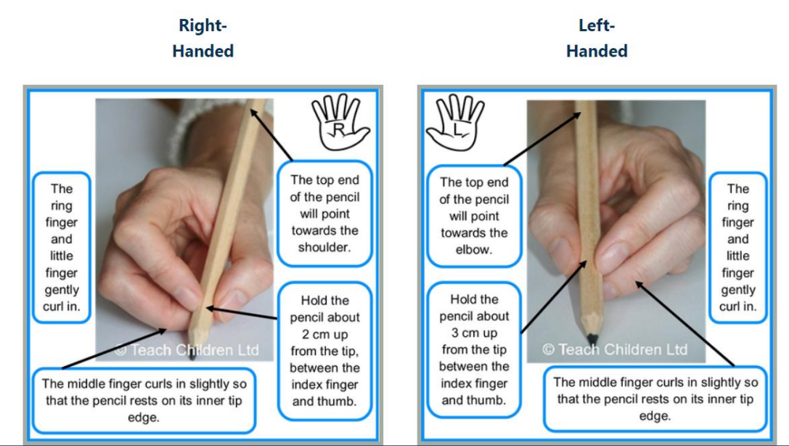
Writing

Slide 12
How does this look in the classroom?
Shared writing experiences- the use of Talk for Writing
Use phonics discretely for reading and writing throughout the whole day
Provide an enabling environment which creates opportunities for these learning experiences
A daily focused 30 minute phonic teaching lesson

Slide 13
Writing – How you can help?
Variety of writing materials
Fine motor skills- Teach Handwriting
Cutting
Handwriting/spelling
Model writing the graphemes
Correct pencil grip
Lowercase letters – capitals only at beginning of sentences, names etc.
Encourage your child to draw/write parts of a shopping list, greetings card, post it message, birthday/Christmas list.
Time to try some of the activities that promote fine motor control.

Slide 14
Useful websites
• https://www.oxfordowl.co.uk/for-home/
• https://www.bbc.co.uk/cbeebies/shows/alphablocks
• https://www.teachyourmonstertoread.com/
• https://www.booksfortopics.com/early-years
• https://teachhandwriting.co.uk/parents.html
• https://www.ictgames.com/mobilePage/literacy.html
• https://www.phonicsplay.co.uk/
• http://www.ruthmiskin.com/en/parents/

