Slide 1
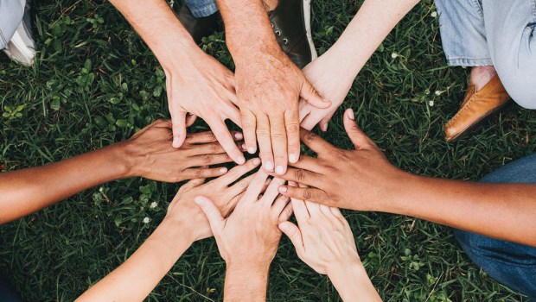
Sports Day
Together in Solidarity!

Slide 2
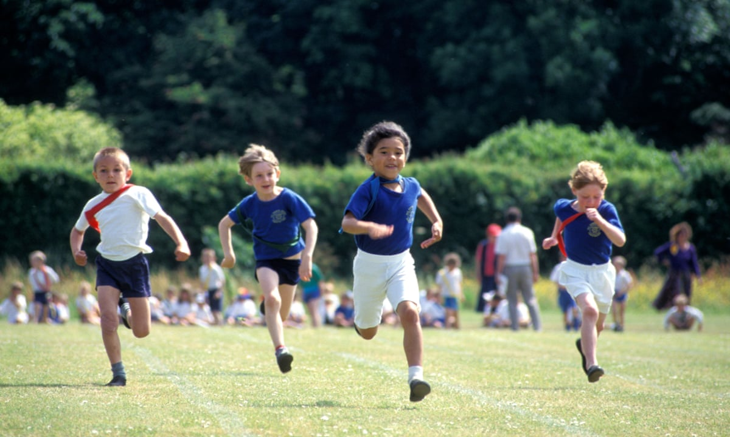
A Day to Shine, Support and Celebrate

Slide 3
What Is Sports Day All About?
A time to:
Have fun
Try your best
Support each other
Celebrate everyone’s achievements
It’s not just about winning – it’s about participating and growing.

Slide 4

Our Focus This Year: Solidarity
Solidarity means standing together and lifting others up! You can show it by…
Cheering on your friends — even if they’re in another house
Waiting patiently for your turn
Helping a friend tie their shoelaces if they come undone
High-fiving someone after a race – win or lose
Encouraging someone who’s nervous to give it a go
Saying “well done” or “good try” to others
Clapping for all participants, not just the winners
Playing fairly and being honest in activities and races

Slide 5

The Sporting Values
Adults will be giving out stickers to those who demonstrate the sporting values:
Honesty – Be truthful and fair
Self-Belief – Believe in yourself, even when it’s hard
Determination – Keep going, don’t give up!
Respect – Be kind and thoughtful to everyone
Teamwork – Work together and support each other
Passion – Enjoy what you’re doing and give it your all!

Slide 6
Prayer
Loving God,
Thank You for this special day –
A day of fun, friendship, and teamwork.
As we run, jump, and cheer each other on,
Help us remember that we are one family.
Let us support one another with kindness,
Celebrate each other’s efforts,
And lift up those who may struggle.
May we play with joy and fairness,
Encourage everyone to do their best,
And show the spirit of St John –
Caring for others and standing together in love.
Amen.

