Slide 1

Teaching Times Tables at St. Johns

Slide 2
Why learn your times tables?
Notes:
Helping their brains work more efficiently.
Two parts of brain – it’s a model…not physical.
Working memory – limited, used to process new information
Long-term memory – unlimited, can be recalled
During new maths learning, need to understand the context, read the question, think about which method to use, how to use the method etc.
Working out times tables on top of this… overload!
AIM → get facts in long-term memory.

Slide 3
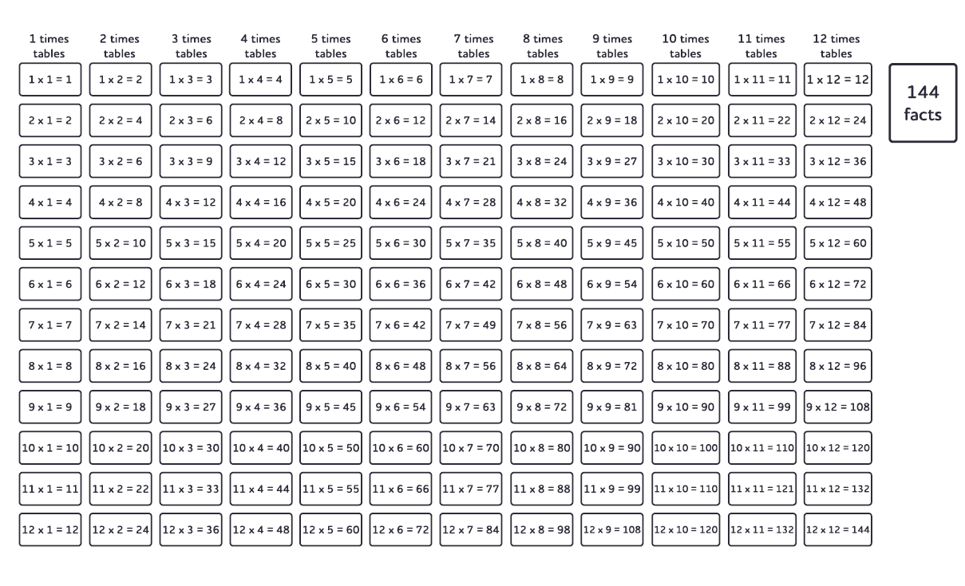

Slide 4
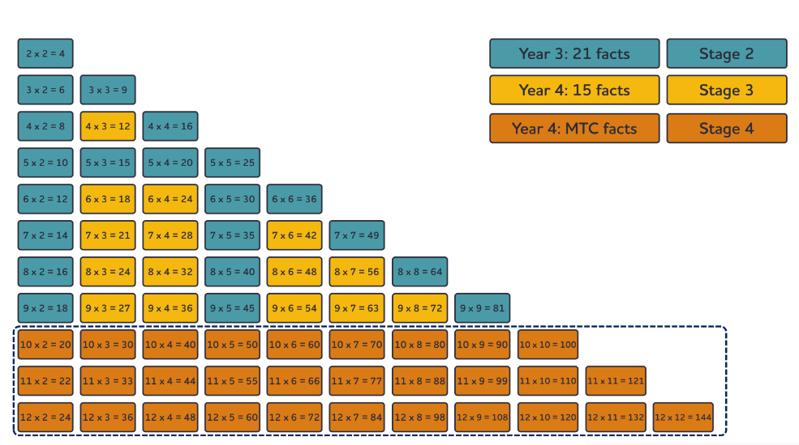
Notes:
36 key facts – prioritised up to 9 x 9
Taught over two years – 3 stages

Slide 5
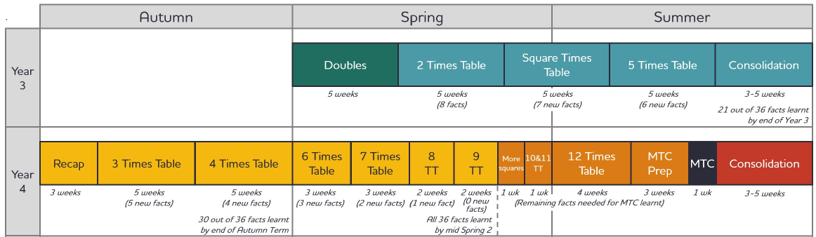

Slide 6
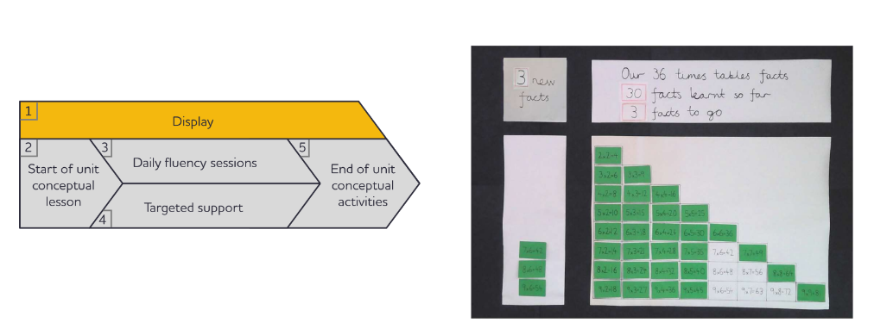
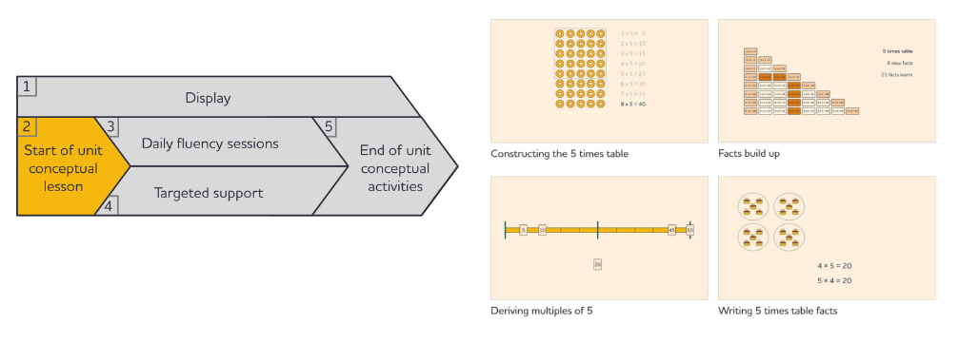
5-Part Structure
Notes:
Display – shows journey, shows not many facts to learn – reassuring
Conceptual lessons – understanding of the concept. 6 x 4 is six, four times.
Daily fluency sessions – will take part in this shortly

Slide 7
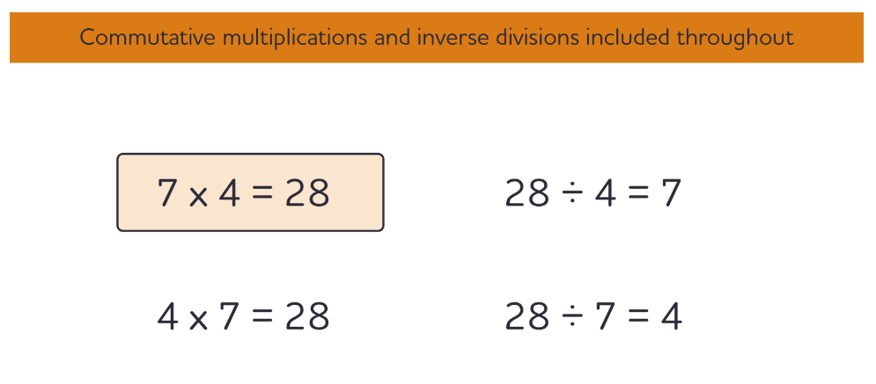
Notes:
How do we learn facts? By hearing lots and by saying lots… like a nursey rhyme. Sound patterns -
Any fact – 3 related facts… part of same fact family.
Don’t say times, equal, divide… cut it all out. Remember less!

Slide 8
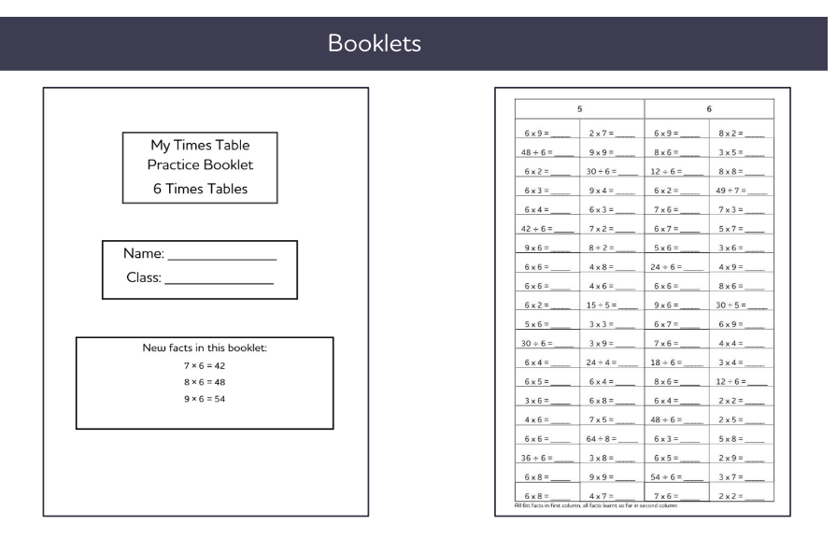
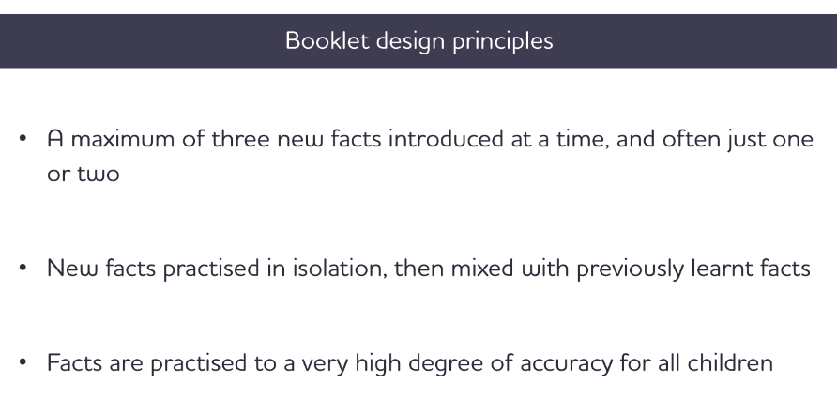

Slide 9
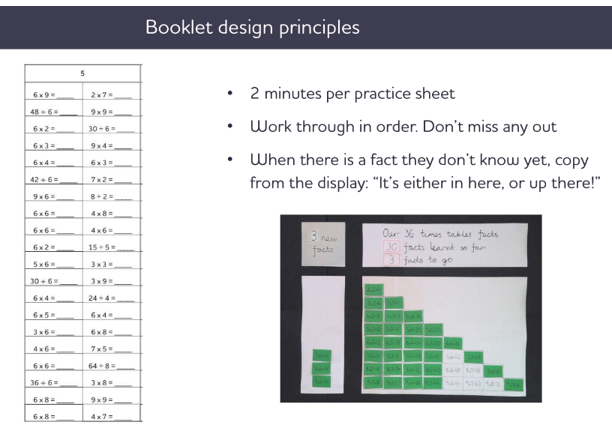

Slide 10
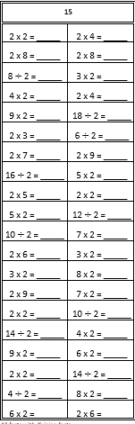
Here is an example of how we practice the times tables (available as booklets on the class pages of our school website).
Division facts are included to consolidate understanding of the multiplication facts within the National Curriculum.
When saying the facts aloud we always use the larger factor (number) first.
i.e. 6 fives are 30 rather than 5 times 6
Key points to remember when at home:
Same phrasing ‘? 2s are…?’
2 minutes to complete the test
Answer questions in the order
Prompt sheet with the facts from the times table they are learning
When checking answers, use choral response
Let’s have a go!
https://www.st-johns-trowbridge.wilts.sch.uk/

Slide 11
What is the Year 4 Multiplication check?
The purpose of the check is to determine whether your child can fluently recall their times tables up to 12, which is essential for future success in mathematics. It will also help us to identify if your child may need additional support.
It is an on-screen check consisting of 25 times table questions. Your child will be able to answer 3 practice questions before taking the actual check. They will then have 6 seconds to answer each question. On average, the check should take no longer than 5 minutes to complete.
Will I receive feedback on my child’s check?
Yes. Your child’s teacher will share your child’s score with you, as they would with all National Curriculum assessments with their end of year report.

Slide 12
How the Year 4 multiplication check is administered:
The government requirement is that the test is administered over a 2 week period from Monday 1st June to Friday 12th June 2026.
We will administer the check within this window.
An adult will supervise the children during the test on the Ipads.
ALL multiplication facts will be tested (no division facts on the actual test)

Slide 13
How can you help your child?
The key facts which the children find tricky are listed below:
6 x 6 = 36 7 x 6 = 42 8 x 6 = 48 8 x 7 = 56 9 x 6 = 54
9 x 7 = 63 9 x 8 = 72
12 x 6 = 72 12 x 7 = 84 12 x 8 = 96 12 x 12 = 144

Slide 14
https://www.timestables.co.uk/multiplication-tables-check/
If you access the ‘Settings’ pick tab you can change the multiplication facts the children are asked to focus on the harder facts.
In the actual test, the children will have 6 seconds to answer each question, with 3-seconds pause between questions. Therefore, they do have time to consider their answer before submitting it.

