Slide 1

Welcome to Years 1 and 2

Slide 2
Curriculum Intent at St John’s Catholic Primary School, Trowbridge
St John’s Catholic Primary School was founded in 1927 by the Sisters of St John of God whose aim was ‘to give concrete expressions to God’s compassionate care for all people and the whole of creation’. Our school delivers an ambitious national curriculum and provides pupils with a sequenced introduction to the essential knowledge that they need to be educated citizens. It introduces pupils to the best that has been thought and said; and helps engender an appreciation of human creativity and achievement. Catholic Social Teaching is embedded into and beyond the classroom-based curriculum.

Slide 3
The Team
Counsel Class – Miss Holmes
Courage Class – Mrs Muxlow
Knowledge Class – Miss McColgan
Support Staff
Mrs Wade
Miss Fowler
Miss Bygrave
Mrs Eaton – Phonics
Mr Emil – PE
Miss Hall - Swimming

Slide 4
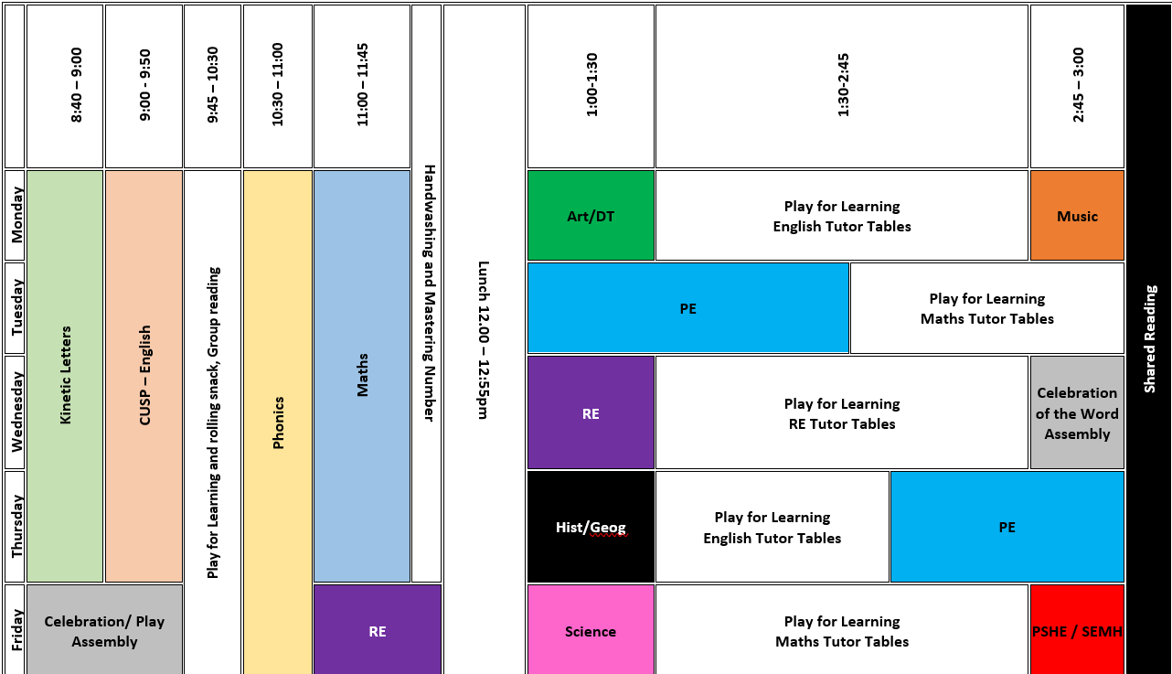
A Typical Timetable
PE Days
Counsel – Tuesday
Courage – Wednesday
Knowledge – Monday
From Term 2, Children will have 2 PE days, this term, we’ve grouped all PE within the swimming day to aid transition

Slide 5

School starts at 8.40am.
Children should be on the playground by 8.40am, ready to go into class.
We would like to remind you that if your child arrives late to school, an adult MUST accompany them to the school office and fill in one of these slips.
Late Slip – to be completed by the parent/carer
Name of Child: _______________________Class:___
Date: ___/___/23 Time:_________ Signed: ___________
Reason for being late to school:_____________________

Slide 6
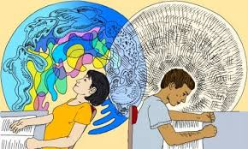
This Year … Continuous Provision
Notes:
This means we have adopted a play-based approach to learning.
Research and our school experience have shown us that children 7 and under learn best through play and exploration.
We are aiming to nurture our children’s social, emotional, physical and spiritual wellbeing while also having high academic aspirations.
We want to enable our children to be independent, resilient learners who are motivated to learn.
We believe that a play-based approach is the best way to do this.
Children will still receive the rigour of academic high standards and a highly ambitious curriculum. It’s all the better when they can consolidate their learning in a developmentally appropriate way.
Ultimately, if children aren’t happy, they can’t learn. We know this and that’s why it’s important to us that your children get adequate transition from EYFS.
The year will progress – so have no fear, they will still certainly be challenged appropriately!

Slide 7
More Information
Notes:
Model finding resources on the website

Slide 8
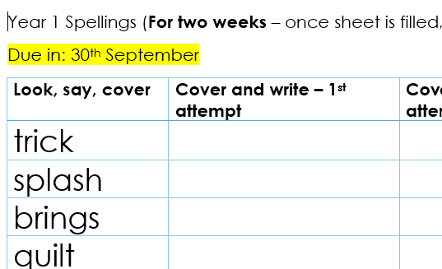
Home Learning
This year our homework will be the words they are required to learn for phonics, allowing them to embed the new spellings they have covered in class.
They will do a spelling test on these words but we won’t send that home.

Slide 9
Top 200 Story Books
From next week, your child will be bringing home a story book each night to enjoy with you. These books are part of our specially selected ‘Top 200 Books’ collection and can be identified by the St John’s sticker on the cover.
This system is designed to ensure that children are regularly exposed to a wide variety of high-quality texts. Over the course of Year 1 and Year 2, your child will have the opportunity to read and enjoy some of the best literature available for their age group, helping to build a lifelong love of reading.
These are not levelled books, but carefully chosen for enjoyment and exposure to rich language. They can be swapped daily – please ensure the book is returned if your child would like a new one.
Phonics Reading Books
In addition, your child will also bring home a phonics reading book each week. These books are carefully matched to the phonics sounds your child has been learning in class and are designed to allow them to perform and celebrate their reading skills with you at home.
These books will focus on sounds taught two weeks prior to support consolidation. Occasionally, if a matching book is not available, your child may receive the text on a printed sheet instead. These books are important for developing decoding skills and should be read aloud regularly at home.

Slide 10
Other Information
Good coats – wettest year ever!
Wellies
Forest School – Year 1s will have forest school on Mondays
Term 1 – Counsel Class
Term 2 – Courage Class
Term 3 – Knowledge Class

Slide 11

Worship
Celebration of the Word - Wednesdays
Chapel Reflection – 1x weekly
Celebration Assembly- Friday morning
Mass for feast days and celebrations

Slide 12
How to keep in touch
We are here for the children – our partnership is crucial
If you cannot catch us in person please send us an email: admin@st-johns-trowbridge.wilts.sch.uk or call the office and we’ll get the message.
Phase leader is Vicky Holmes (Counsel Class)

Slide 13
No reading records, Top 200 books
We cannot emphasise enough how important it is for children to read with an adult every day, and we want to make sure your time at home is focused on sharing and enjoying books, not on writing about it.

