Slide 1

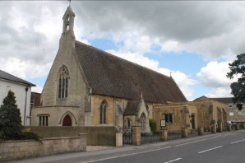
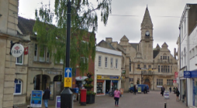

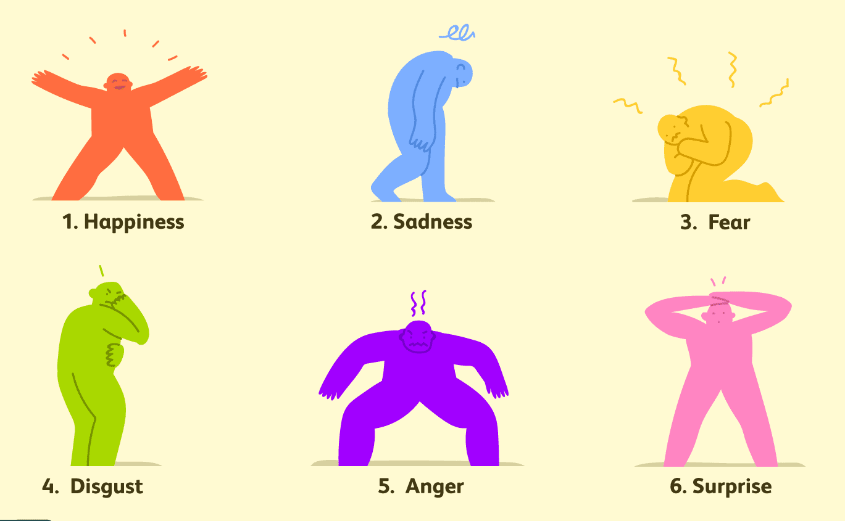



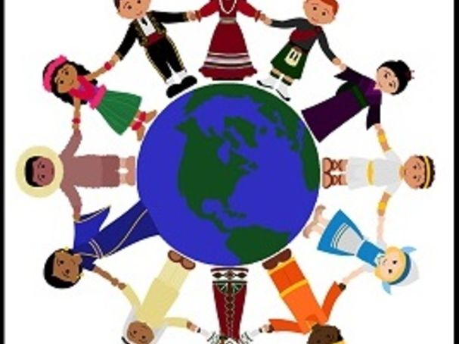

St John’s Catholic Primary School
Catholic Social Teaching: Family and community
Topic: How am I Unique? | Year group: EYFS | Focus area: UTW
What will we use this knowledge to do
Understand our feelings and emotions Discover what makes you unique? Think about our families Recognise the communities we belong to
Key Vocabulary
Community
Church
Town
Feelings
Emotions
Unique
God
Dignity
Things to talk about
What makes you unique?
What gifts has God given you?
Tell me about your family
Where do you live?
What communities are you part of?
Where can you go in Trowbridge?
What I will know
God made us unique - God created us to be unique. You are a masterpiece! There is not another person like you.
Emotion - An emotion is a person's inner feeling. Some examples of emotions are anger, fear, joy and guilt
Town - A town is a place where people live. Towns are generally larger than villages but smaller than cities
Community - a group of people that share something in common.
Kitchen Table Discussion
What activities do you enjoy doing together at home?

