Slide 1


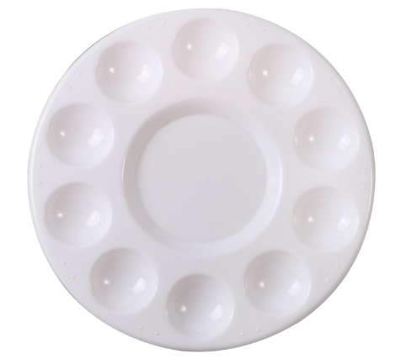
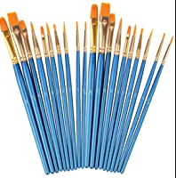
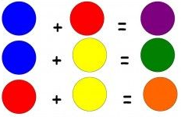
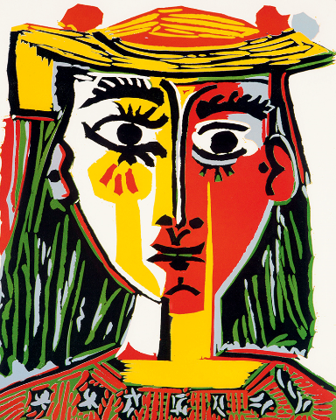
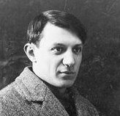

St John’s Catholic Primary School
Catholic Social Teaching:
Topic: How Did God Make Us Unique? | Year group: FS | Focus area: Painting
What will we use this knowledge to do
Mix primary colours to make secondary colours Use the resources well when colour mixing, e.g. the correct amount of paint.
Key Vocabulary
Primary colours
Secondary colours
Palette
Paintbrush
Colour mixing
Red
Blue
Yellow
Things to talk about
How can we mix two colours together?
How should we hold a paintbrush?
What other tools could you use to paint with?
Green
Orange
Purple
What I will know
The primary colours are red, yellow and blue.
Secondary colours are made by mixing the primary colours.
Colour mixing is when two or more colours are put together to make new colours.
To select the correct size tool for the painting job
Artist focus
Pablo Picasso’s paintings were very bright in colour and he used very clear and simple lines.

