Slide 1

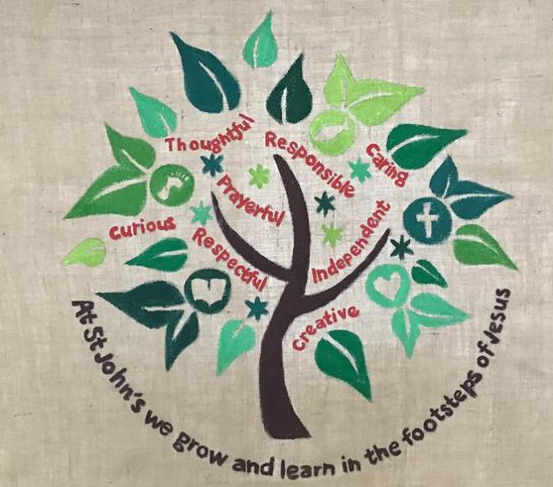
At St John's Catholic Primary School, Trowbridge we are called to love as a Catholic community at the service of the Church's educational mission.
The Mission of St. John’s Catholic Primary School is to grow and learn in the footsteps of Jesus by being: responsible, caring, prayerful, creative, independent, thoughtful, curious and respectful.
We live our Mission by:
Ensuring that our attitudes and values are transmitted through a curriculum that is consistent with the Catholic faith
Delivering a curriculum that is relevant, varied, interesting, stimulating, balanced and appropriate.
Catholic ethos- Relationship and Health Education programme that meets the government’s statutory RSE guidelines

Slide 2



The 2026 RSHE Guidance: A Statutory Requirement
https://assets.publishing.service.gov.uk/media/6970e7e67e827090d02d42e0/Relationships_education_relationships_and_sex_education__RSE__and_health_education__for_intro_1_September_2026_.pdf
Published July 2025
Mandatory from 1 September 2026
Applies to Everyone
Department for Education releases comprehensive updated guidance
All school staff, governors, and leadership teams must be informed and prepared
Full implementation required across all schools in England
This isn't optional guidance—it's a legal requirement that will shape how we support young people's development, wellbeing, and safety for years to come.

Slide 3
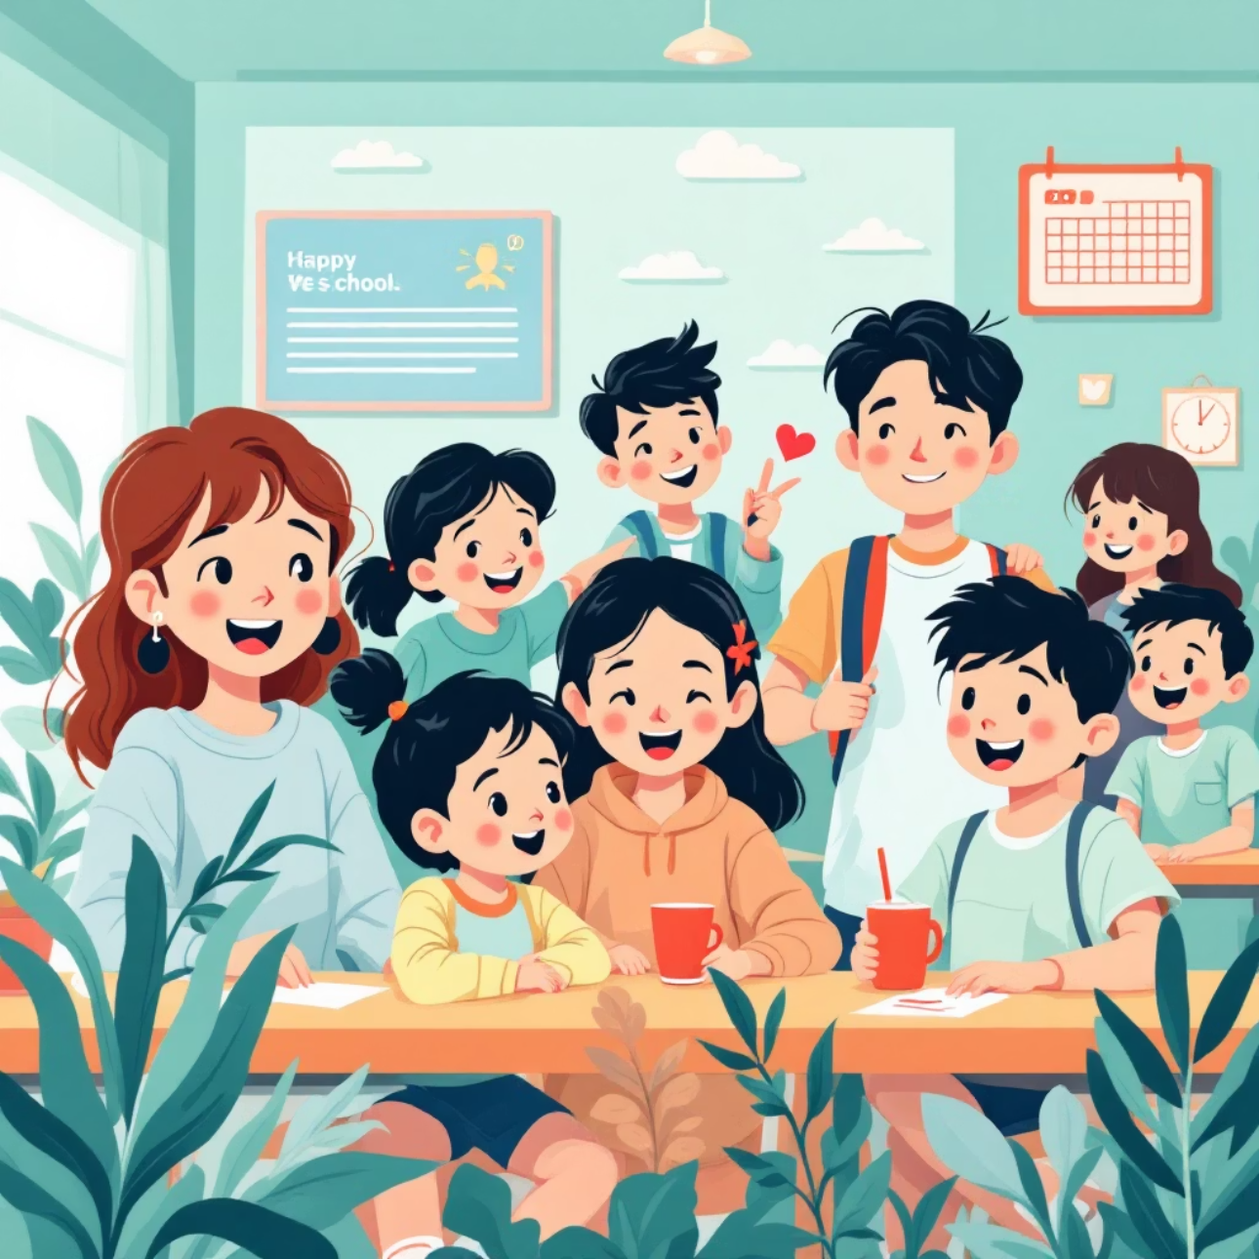
Why Update RSHE Now?
01
02
Rising Wellbeing Concerns
Real-Life Preparedness
Address increasing concerns about children's mental health, online risks, and relationship challenges in a rapidly changing world
Equip pupils with essential knowledge and practical skills to navigate complex real-world situations confidently
03
Building Resilience
Foster emotional literacy, resilience, and respectful relationships that will serve pupils throughout their lives

Slide 4
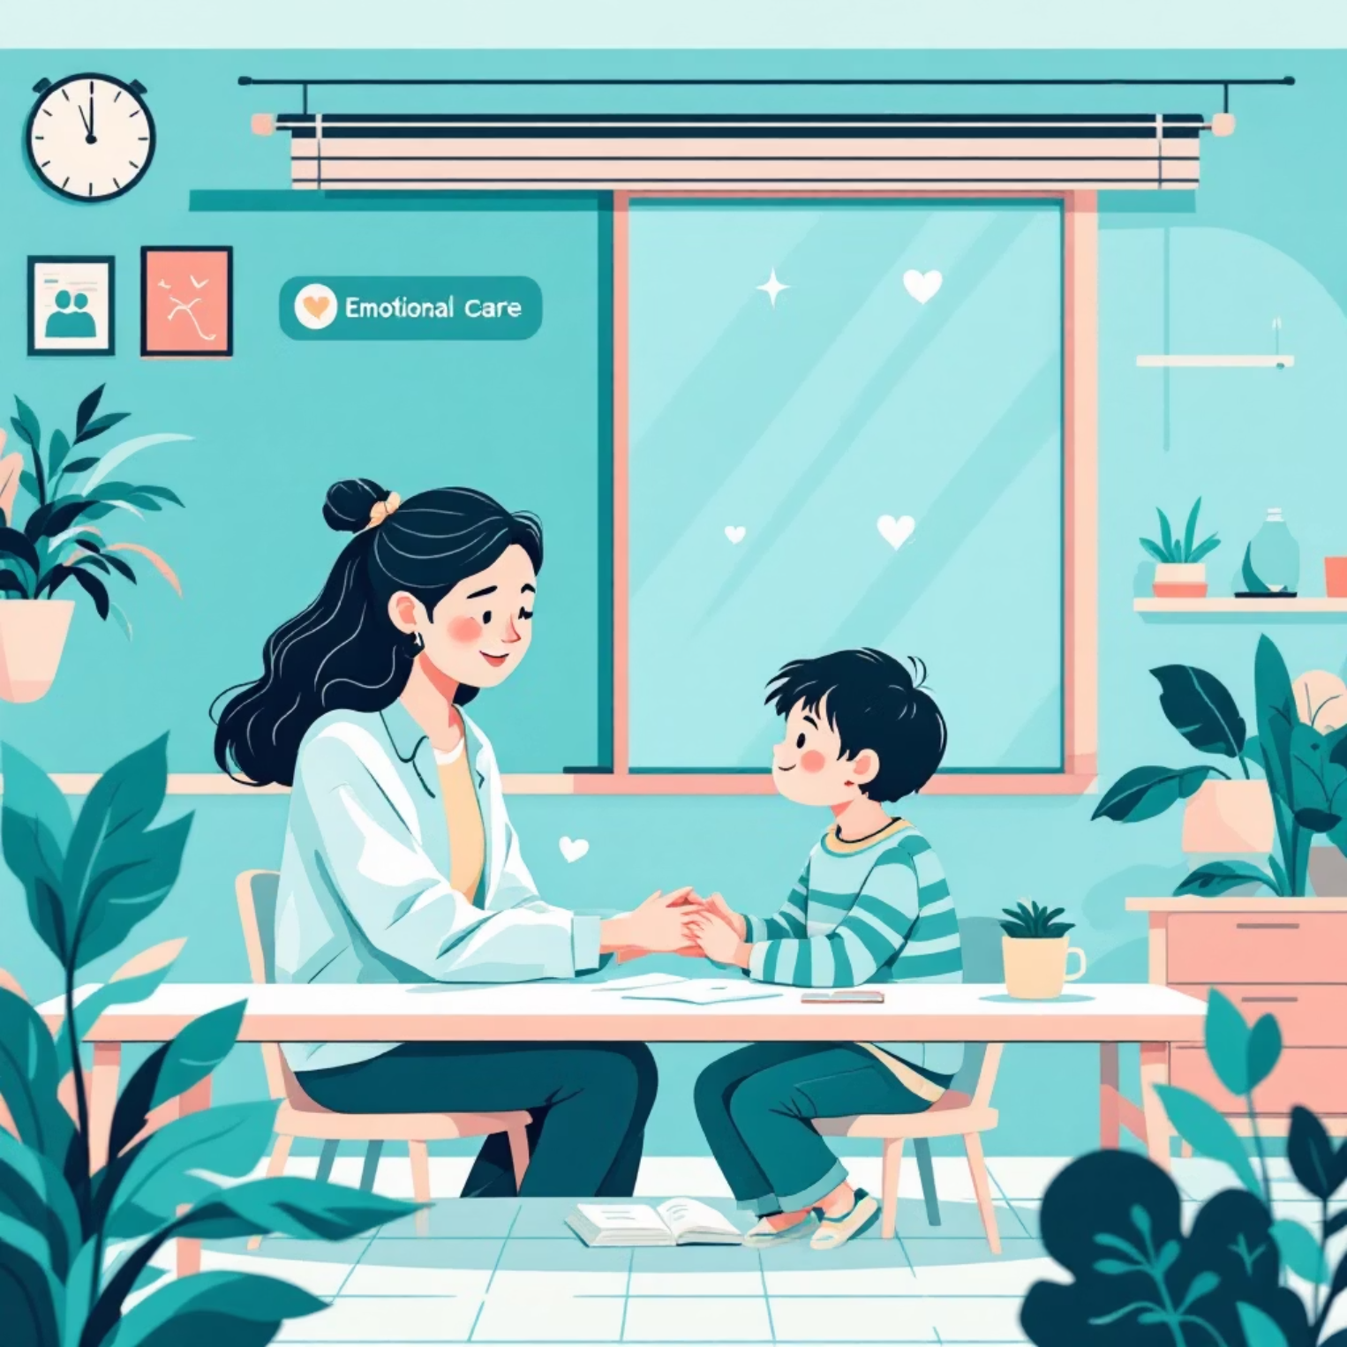
Introducing Grief and Loss Education
Historic Inclusion
For the first time, grief and bereavement are formally included in RSHE curriculum requirements
Diverse Perspectives
Children learn about diverse ways of grieving and how to support peers experiencing loss
Building Resilience
Breaking stigma around death and loss whilst building emotional resilience and understanding

Slide 5



Sexual Harassment and Violence: A Dedicated Focus
Victim Support
Secondary Education
Clear emphasis that it is never the victim's fault, with signposting to support services and trusted adults
Primary Foundation
Young pupils introduced to respectful communication, body boundaries, and appropriate behaviour from the earliest years
Older pupils learn explicitly about sexual harassment, violence, consent, and healthy relationships

Slide 6
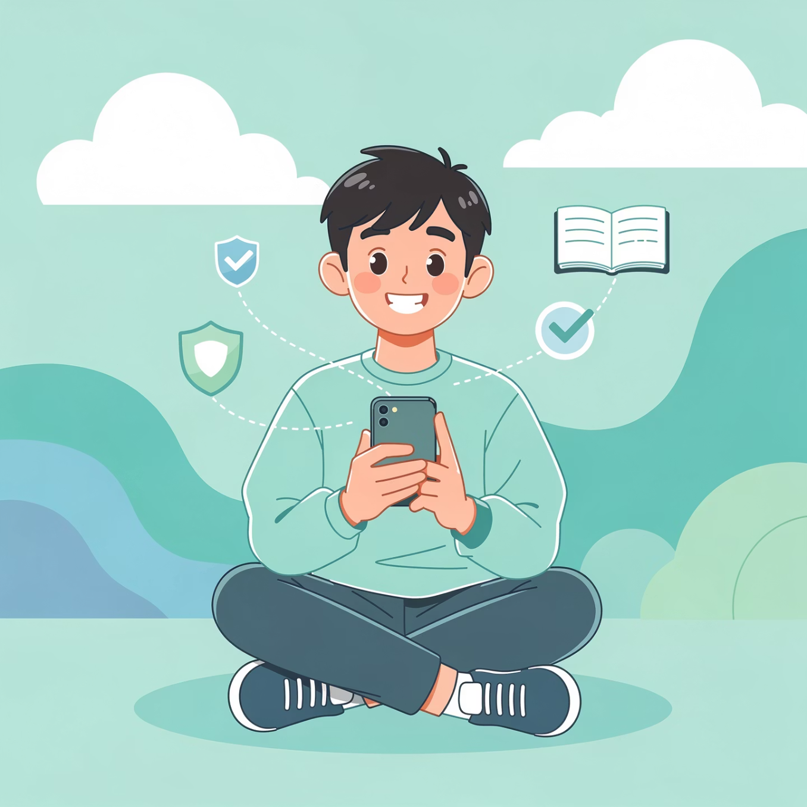
Tackling Online Safety and Misogyny
Digital Literacy
Teaching pupils to identify fake social media accounts, deepfakes, scams, and manipulated content in an increasingly complex online world
Harmful Content
Addressing age-inappropriate exposure to pornography and harmful online subcultures with age-appropriate guidance
Challenging Misogyny
Helping boys recognise and challenge misogynistic attitudes without stigma, fostering respect for all genders

Slide 7
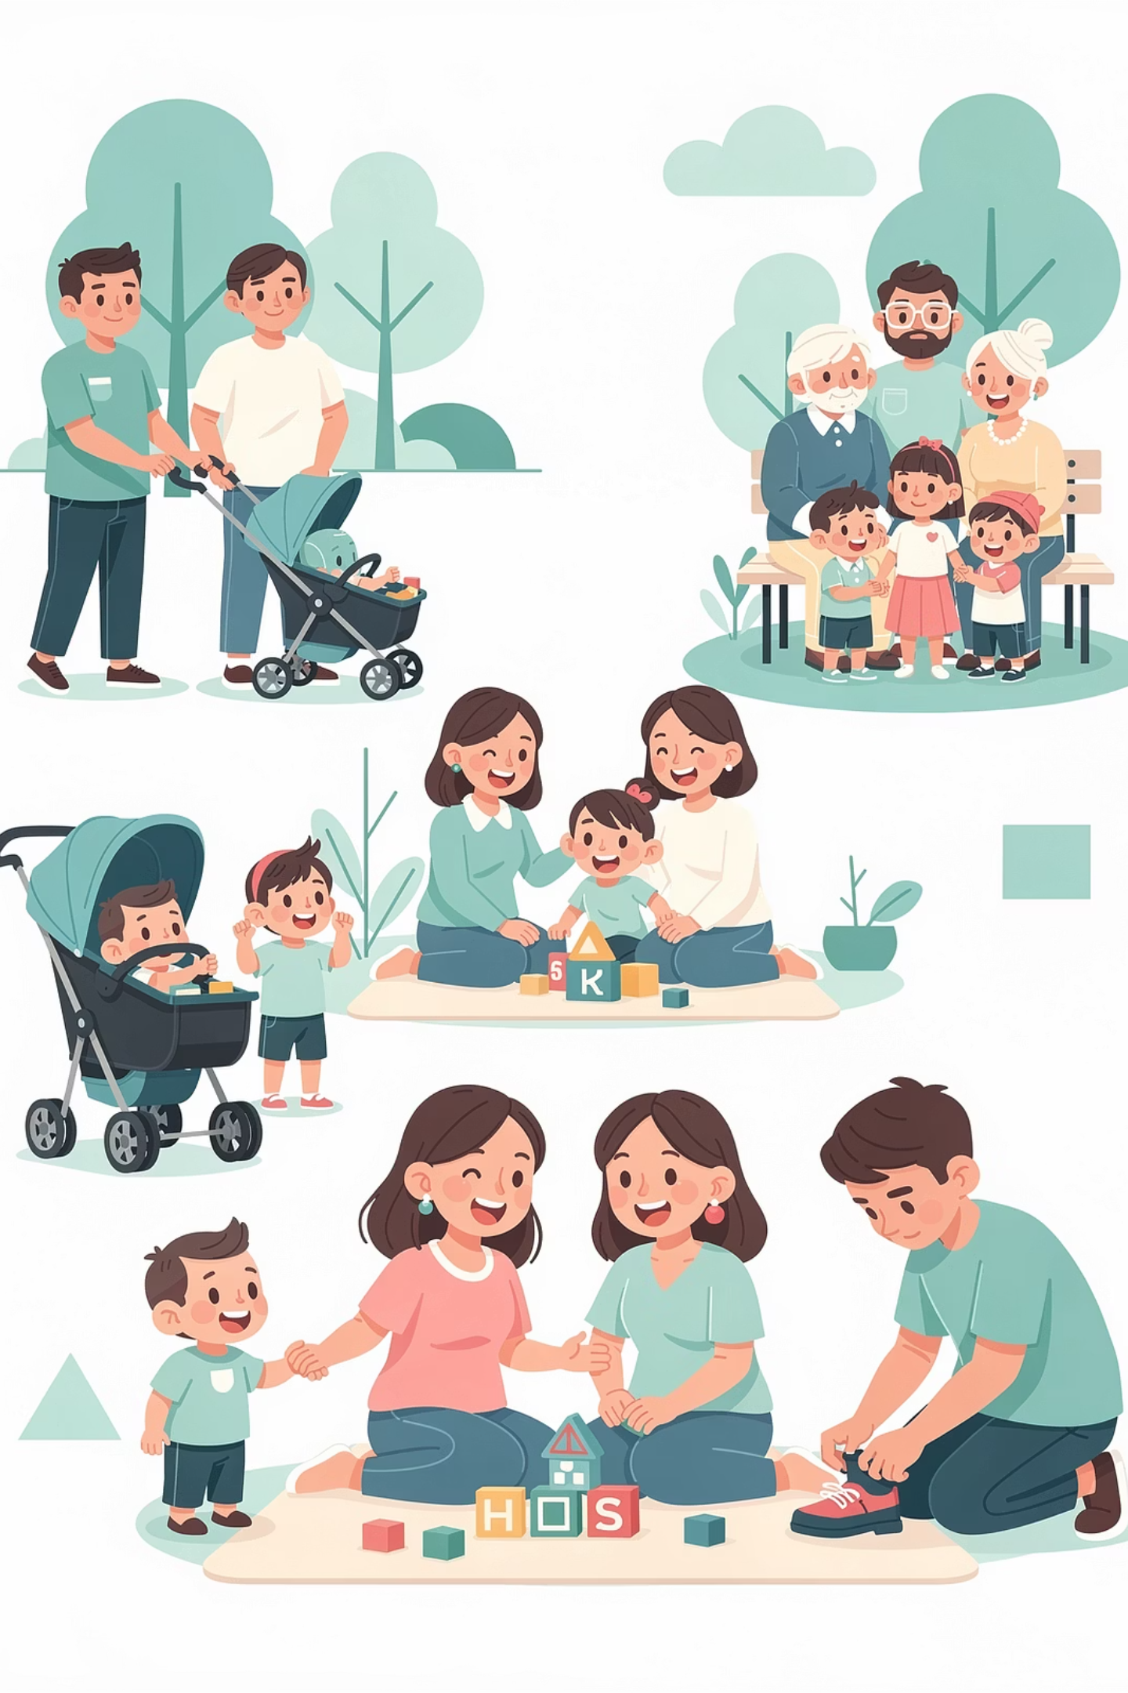
LGBT+ Inclusion and Family Diversity
Primary Education
Secondary Education
Age-appropriate teaching about same-sex parents, diverse family structures, and the fundamental principle that families come in many forms—all equally valid and loving.
Comprehensive LGBT+ content thoughtfully integrated throughout RSHE, covering identity, relationships, and support networks.
Understanding gender identity and sexual orientation
Different types of families and relationships
Challenging discrimination and prejudice
Respectful language and attitudes
Celebrating diversity in our communities
Accessing appropriate support and resources

Slide 8
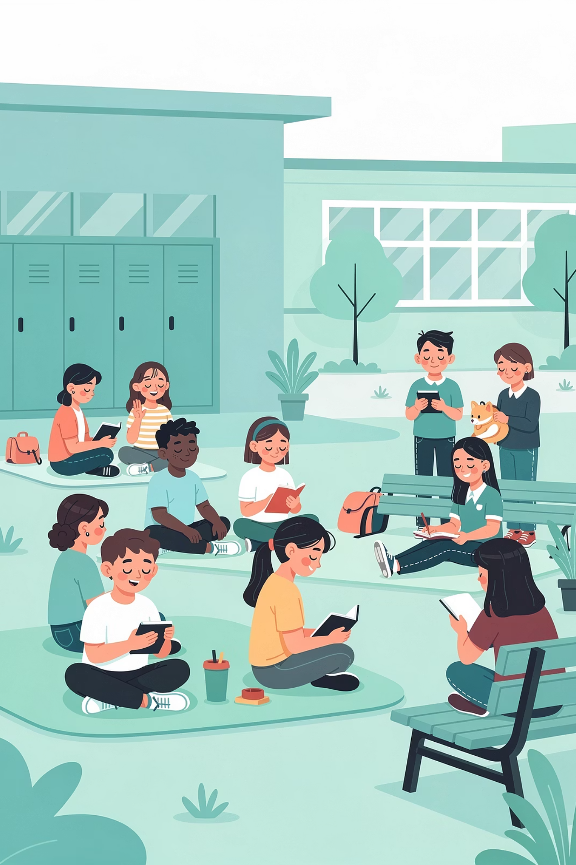



Mental Health and Wellbeing Integration
Normalising Emotions
Creating safe spaces to discuss worry, anxiety, low mood, and other challenging feelings as normal human experiences everyone encounters
Building Resilience
Teaching practical emotional regulation skills, coping strategies, and techniques for managing stress in healthy, constructive ways
Suicide Prevention
Age-appropriate suicide prevention education in secondary schools, focusing on recognising warning signs and accessing help

Slide 9

Notes:
Introduction (3 mins)
Slide 1
Welcome your parents to the Relationship and Health Education parent session.
In this brief introduction, explain:
What your school is doing (implementing a new Catholic ethos Relationship and Health Education programme that meets the government’s new statutory RSE guidelines)
Why your school is choosing to use the programme (e.g. recommended by the diocese/another school, to meet criteria for statutory RSE, growing partnership with Ten Ten Resources etc.)
Who Ten Ten Resources is (an award-winning theatre, film and educational organisation working in Catholic primary and secondary schools throughout the UK
When the programme will be rolled out in school

Slide 10

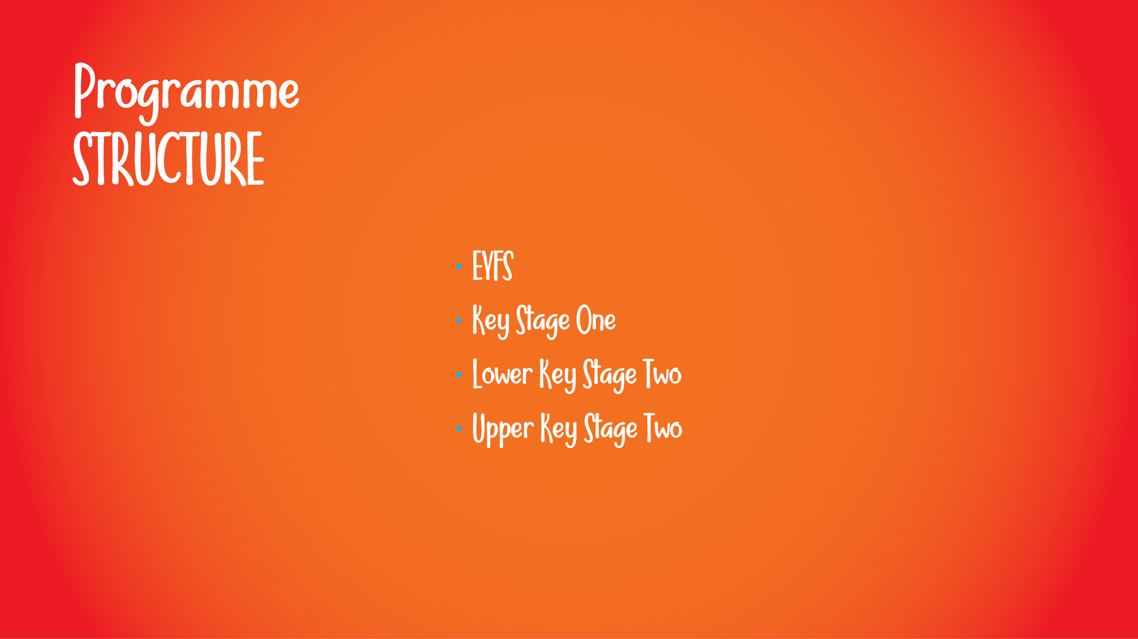
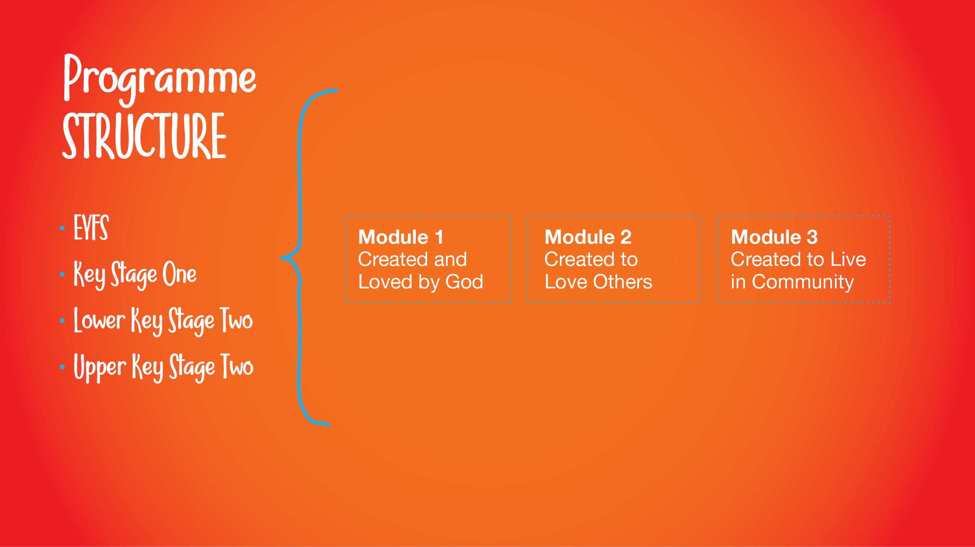
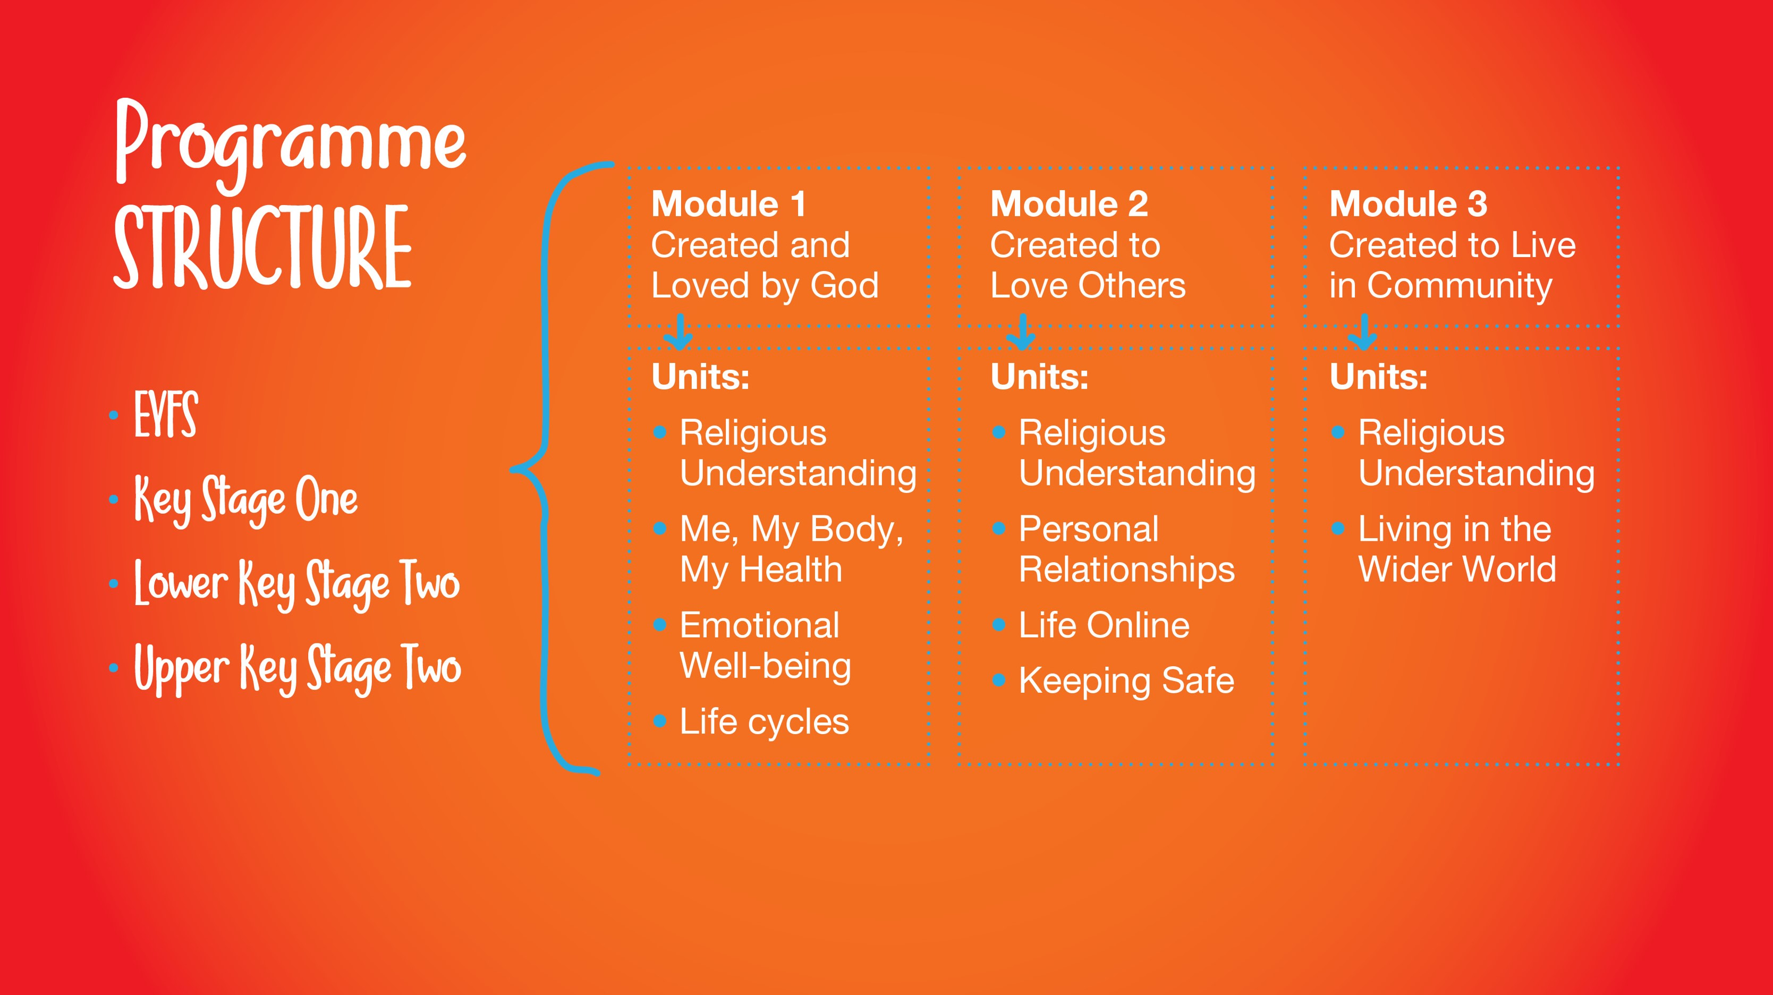
Notes:
Programme Content (3 mins)
Slide 4
Handout a copy of Appendix One: A5 Booklet to every parent.
Using the booklets and slides for reference, provide a brief overview of the programme structure.
Learning Stages
Explain that the programme adopts a spiral curriculum taught across 3 learning stages. Click to reveal the 3 learning stages and explain the year groups they relate to:
Early Years Foundation Stage is aimed at Preschool and Reception
Key Stage One is aimed at Years 1 and 2
Lower Key Stage Two is aimed at Years 3 and 4
Upper Key Stage Two is aimed at Years 5 and 6
Modules
Explain that each learning stage covers the same 3 modules. Click to reveal the titles of the 3 modules:
Created and Loved by God
Created to Love Others
Created to Live in Community
We will discuss these in more detail later.
Units
Explain that each module also covers the same Unit topics across each learning stage. Click to reveal the titles of the Units within each Module:
Module 1 Units
Religious Understanding
Me, my body, my health
Emotional well-being
Life cycles
Module 2 Units
Religious Understanding
Personal Relationships
Life Online
Keeping Safe
Module 3 Units
Religious Understanding
Living in the Wider World
Lessons
Finally, click reveal the term ‘Various lessons and sessions’ to explain that each unit contains a number of lessons and sessions to be led in the classroom.

Slide 11
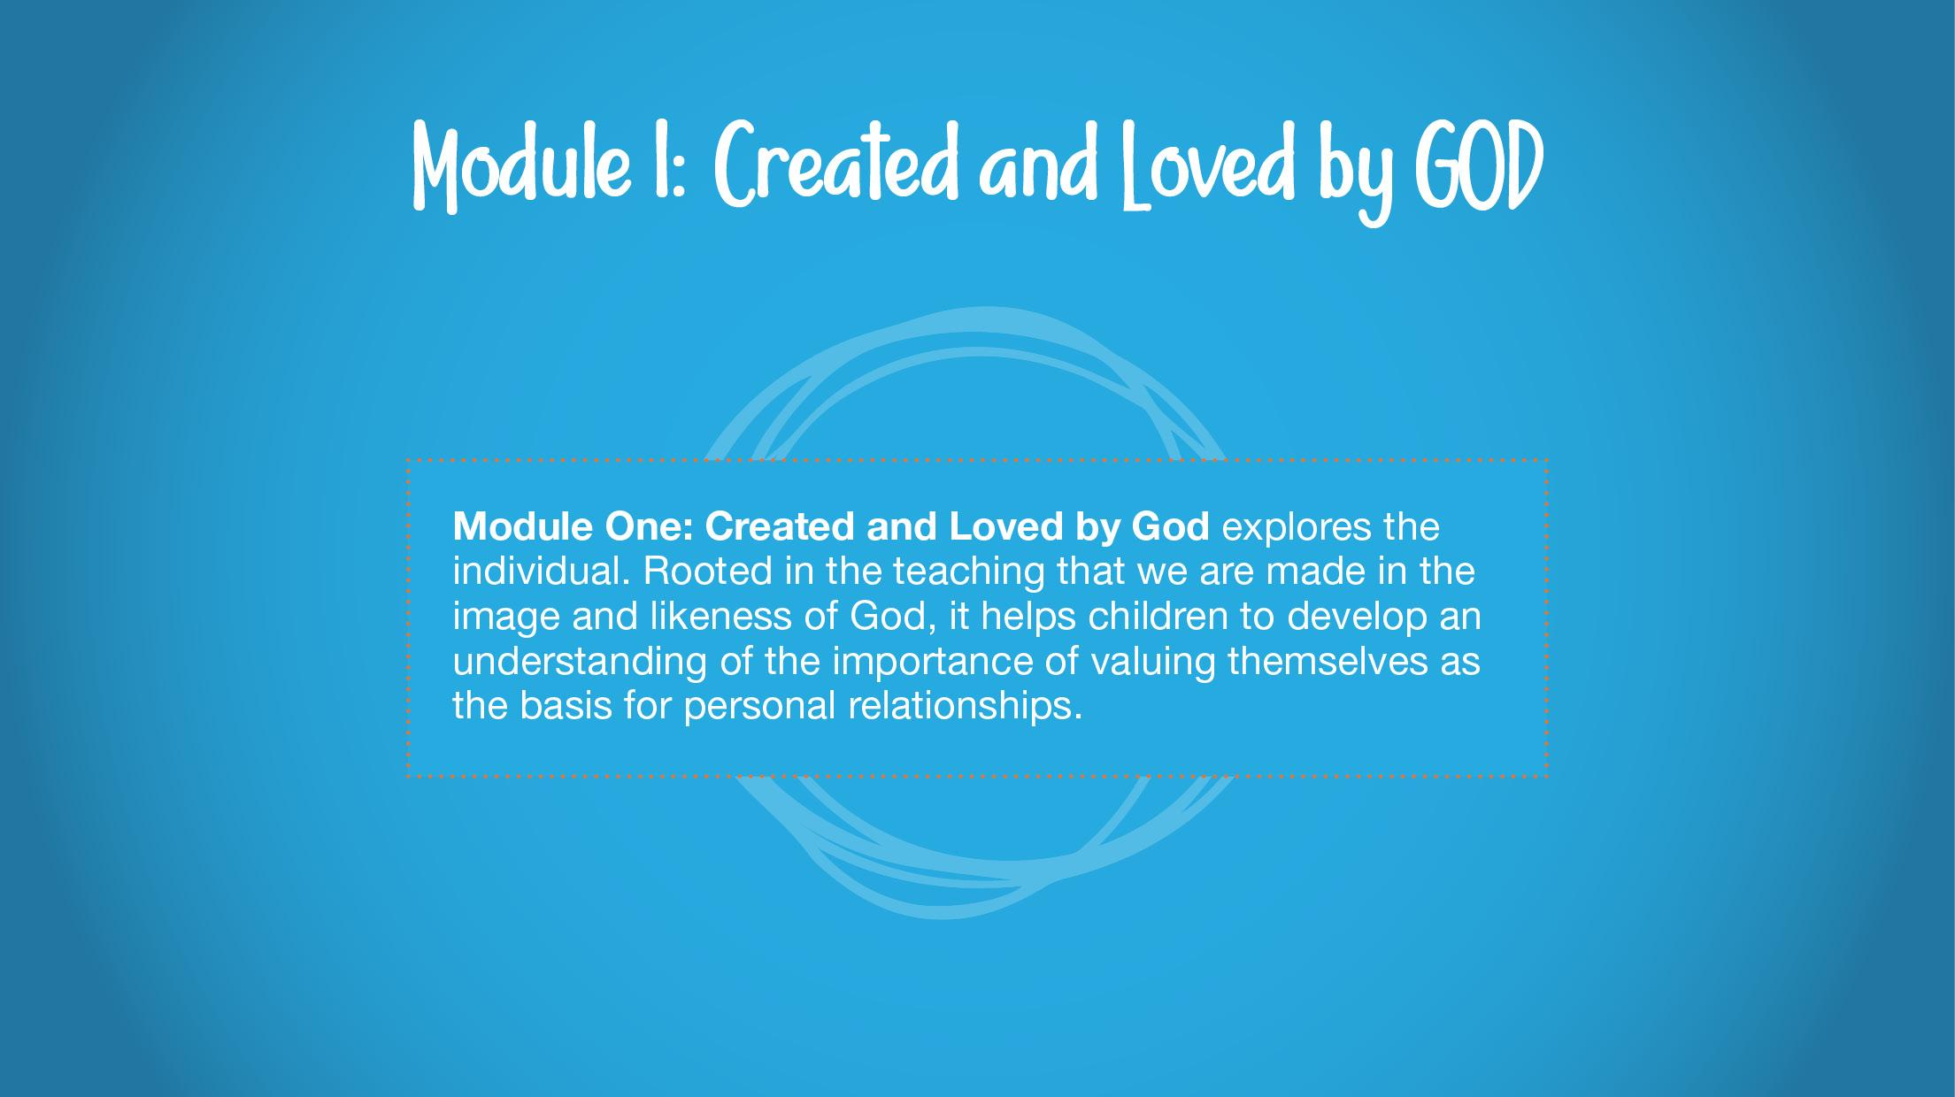
Notes:
Module One in detail (5 mins)
Slide 5
Module One: Created and Loved by God
Using the text on screen, explain that Module One: Created and Loved by God explores the individual. Rooted in the teaching that we are made in the image and likeness of God, it helps children to develop an understanding of the importance of valuing themselves as the basis for personal relationships.

Slide 12
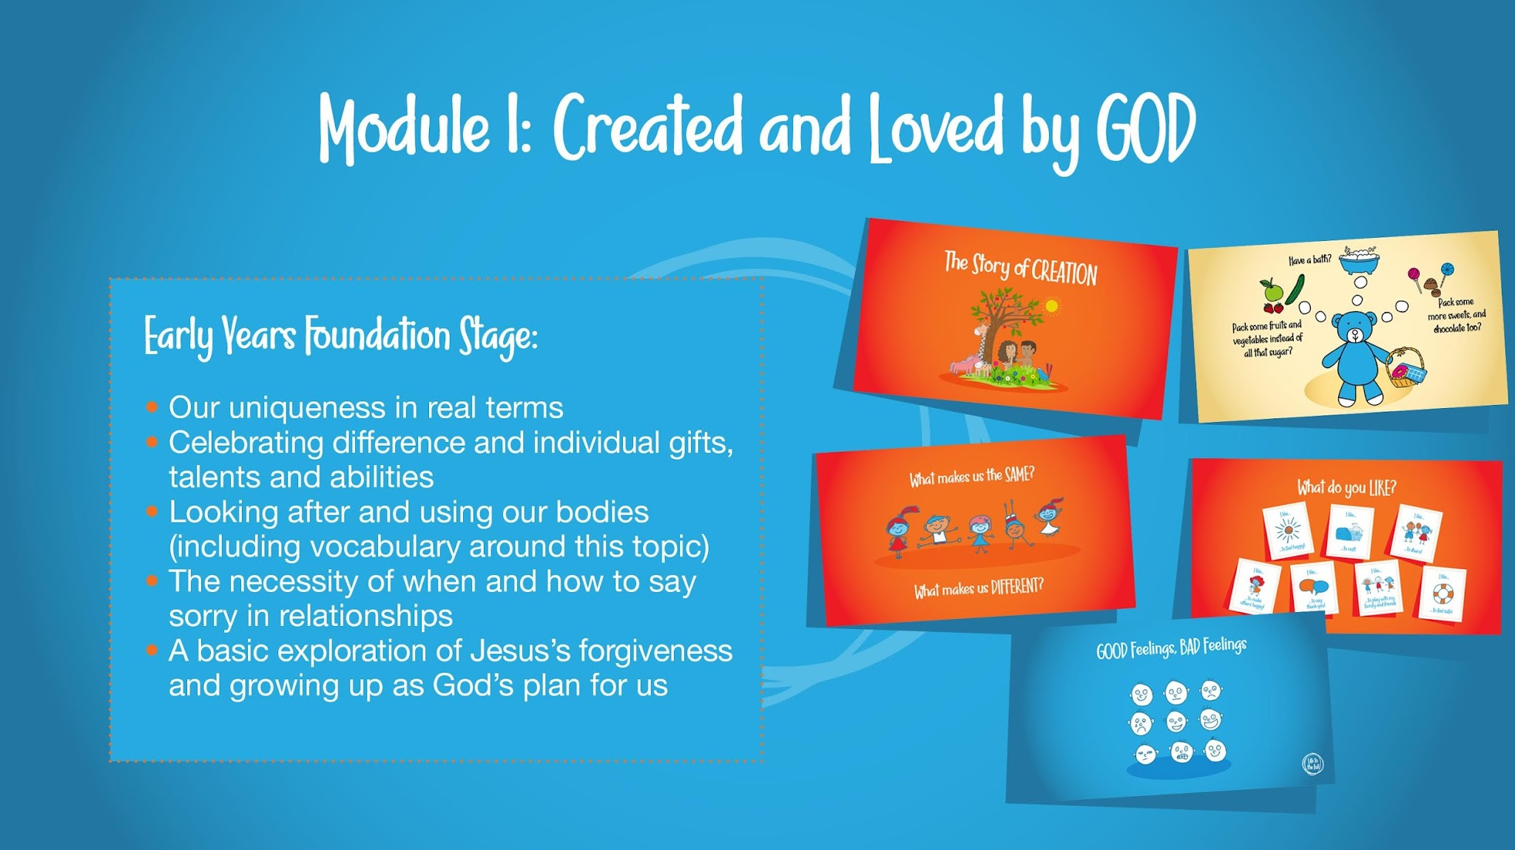
Notes:
Slide 7
Building on this religious understanding of the meaning and purpose of our bodies, children are then taken through a variety of age-appropriate sessions which explore body and health issues.
Click to reveal an overview of the content at each learning stage:
Early Years Foundation Stage - our uniqueness in real terms, including celebrating difference and individual gifts, talents and abilities, looking after and using our bodies (including vocabulary around this topic), the necessity of when and how to say sorry in relationships, a basic exploration of Jesus’s forgiveness and growing up as God’s plan for us.

Slide 13
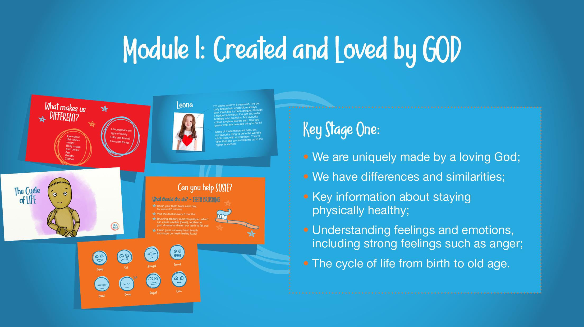
Notes:
Slide 8
Key Stage One – explores that we are uniquely made by a loving God, that we have differences and similarities (including physical differences between boys and girls)**, key information about staying physically healthy, understanding feelings and emotions, including strong feelings such as anger, and the cycle of life from birth to old age.

Slide 14
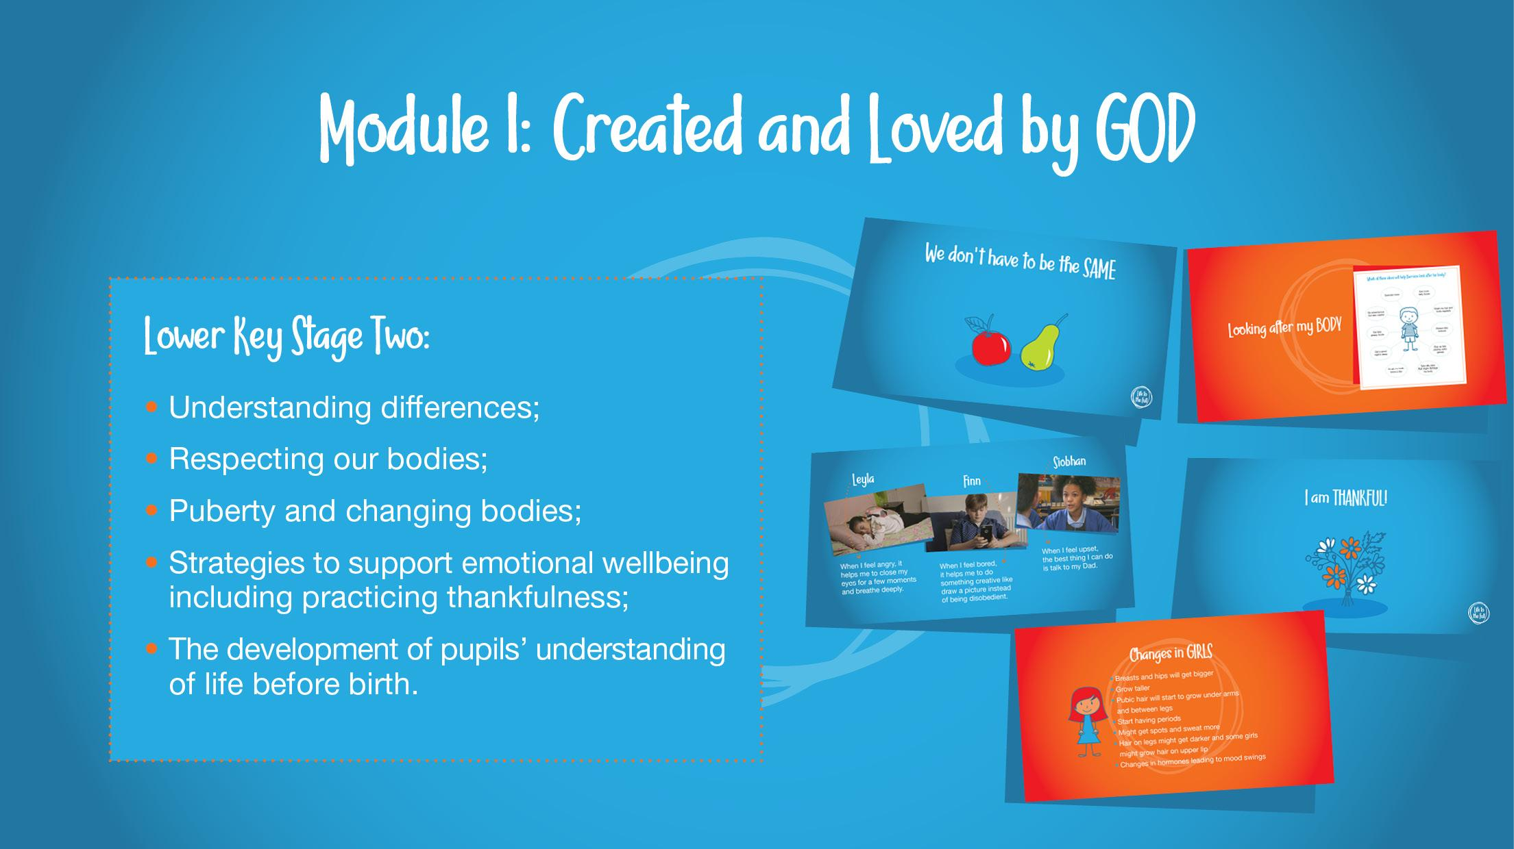
Notes:
Slide 9
Lower Key Stage Two – understanding differences, respecting our bodies, puberty and changing bodies**, strategies to support emotional wellbeing including practising thankfulness, and the development of pupils' understanding of life before birth.

Slide 15
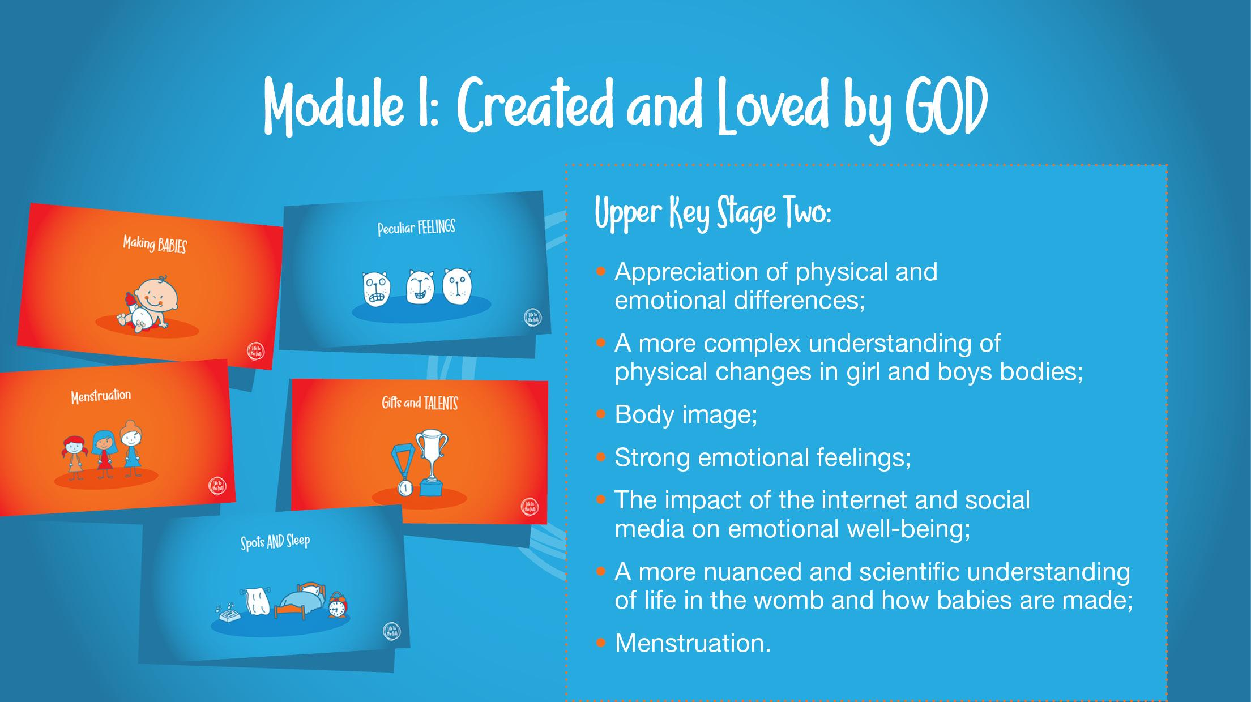
Notes:
Slide 10
Upper Key Stage Two – appreciation of physical and emotional differences, a more complex understanding of physical changes in girl and boys bodies, body image, strong emotional feelings, the impact of the internet and social media on emotional well-being, a more nuanced and scientific understanding of life in the womb and how babies are made**, and menstruation.
As Session Leader, to familiarise yourself with the information regarding Key Decisions concerning genitalia (KS1), puberty (LKS2), pornography (UKS2) and sexual intimacy (UKS2) and more. You have the option to discuss these Key Decisions with parents later in this session.

Slide 16
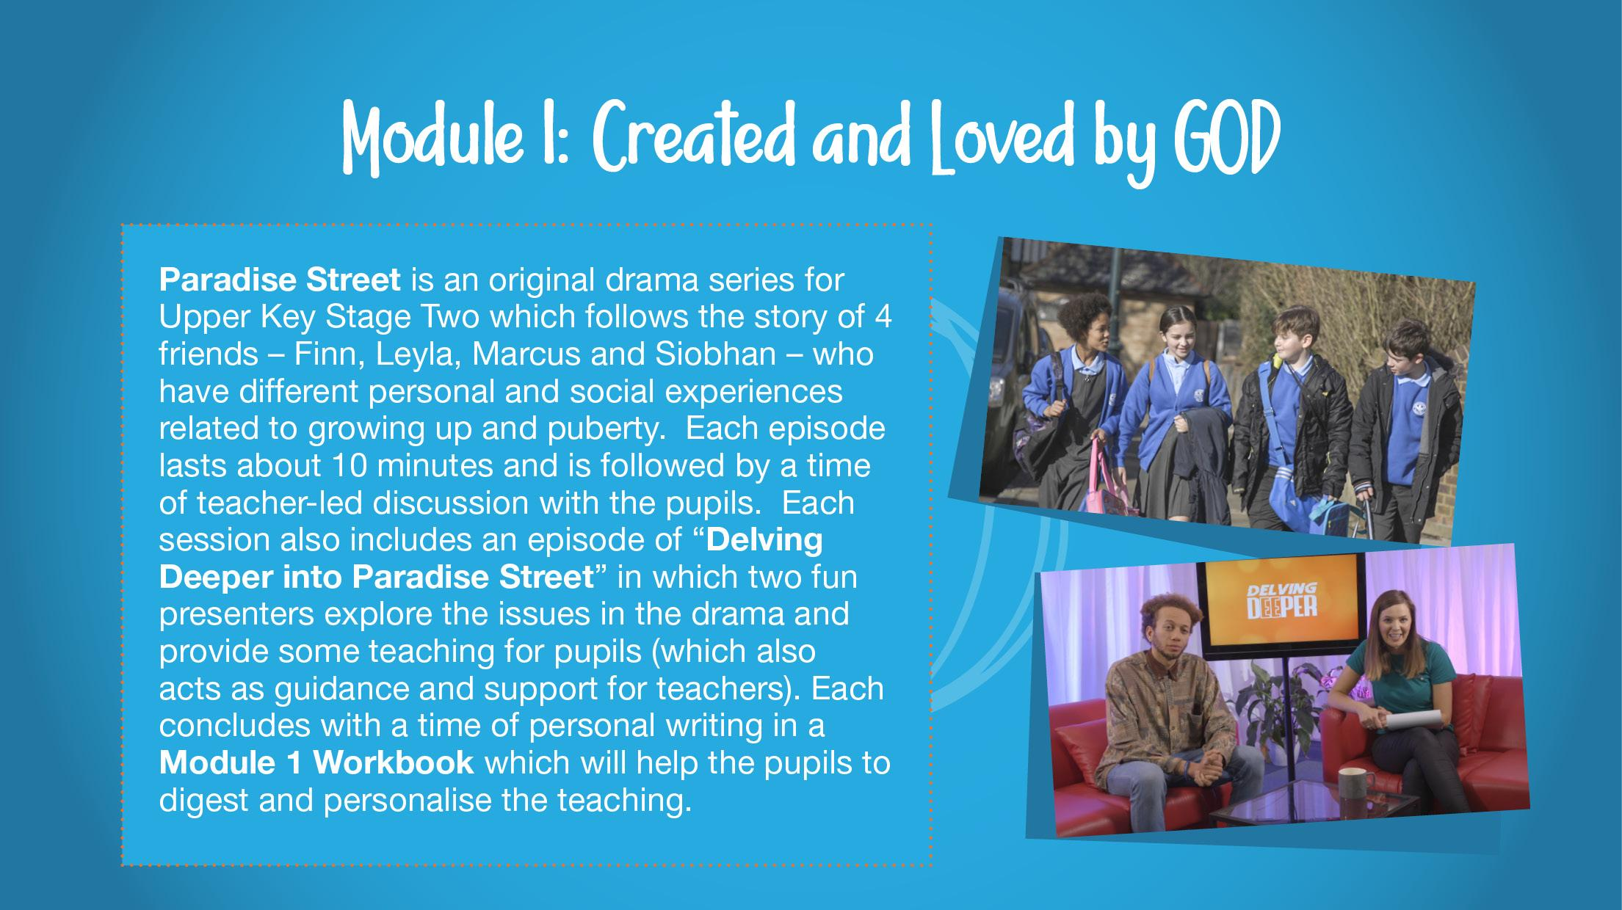
Notes:
Slide 11
Explain that there are 11 sessions in Module 1 of Upper Key Stage Two which are structured around an original drama series by Ten Ten called Paradise Street.
Invite staff to quietly read the text on screen for a moment or two. It says:
Paradise Street is an original drama series for Upper Key Stage Two which follows the story of 4 friends – Finn, Leyla, Marcus and Siobhan – who have different personal and social experiences related to growing up and puberty. Each episode lasts about 10 minutes and is followed by a time of teacher-led discussion with the pupils. Each session also includes an episode of “Delving Deeper into Paradise Street” in which two fun presenters explore the issues in the drama and provide some teaching for pupils (which also acts as guidance and support for teachers). Each concludes with a time of personal writing in a Module 1 Workbook which will help the pupils to digest and personalise the teaching.

Slide 17
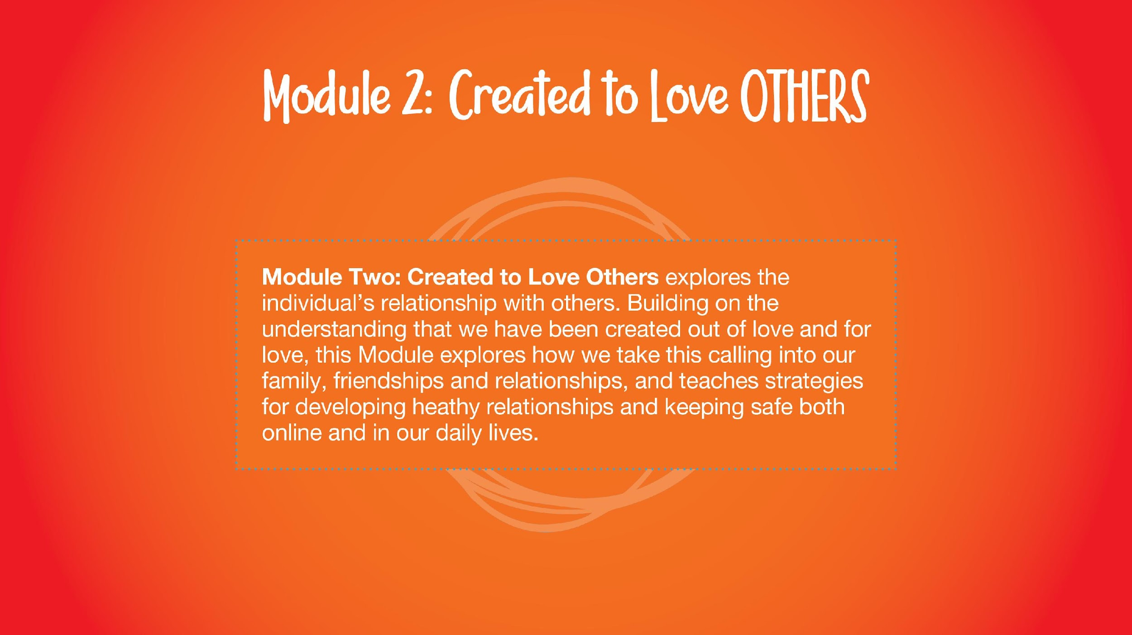
Notes:
Module Two in detail (4 mins)
Slide 13
Module Two: Created to Love Others
Using the text on screen, explain that Module Two: Created to Love Others explores the individual’s relationship with others. Building on the understanding that we have been created out of love and for love, this Module explores how we take this calling into our family, friendships and relationships, and teaches strategies for developing healthy relationships and keeping safe both online and in our daily lives.

Slide 18
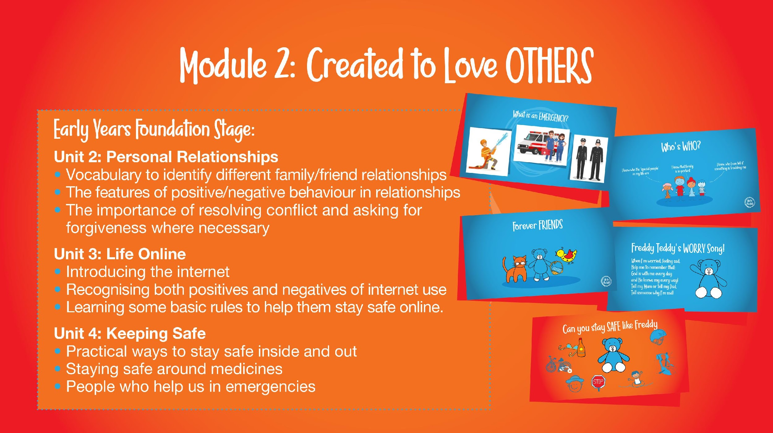
Notes:
Slide 15
This religious understanding is then applied to real-world situations relevant to the age and stage of the children:
Early Years Foundation Stage – In the Unit 2 ‘Personal Relationships’, children will expand their vocabulary by applying names to different family/friend relationships, consider positive/negative behaviour in relationships and learn to look to Jesus as their role model for a good friend. They will learn to resolve conflict and the importance of asking for forgiveness when necessary.
In Unit 3, ‘Life Online’ children are introduced to the positives and negatives of using the internet, alongside tips for keeping safe online.
In the Unit 4 ‘Keeping Safe’, children learn about practical ways to stay safe inside and out, including medicine safety and people who help us in emergencies (a session that can be linked to the ‘People Who Help Us’ topic in EYFS).

Slide 19
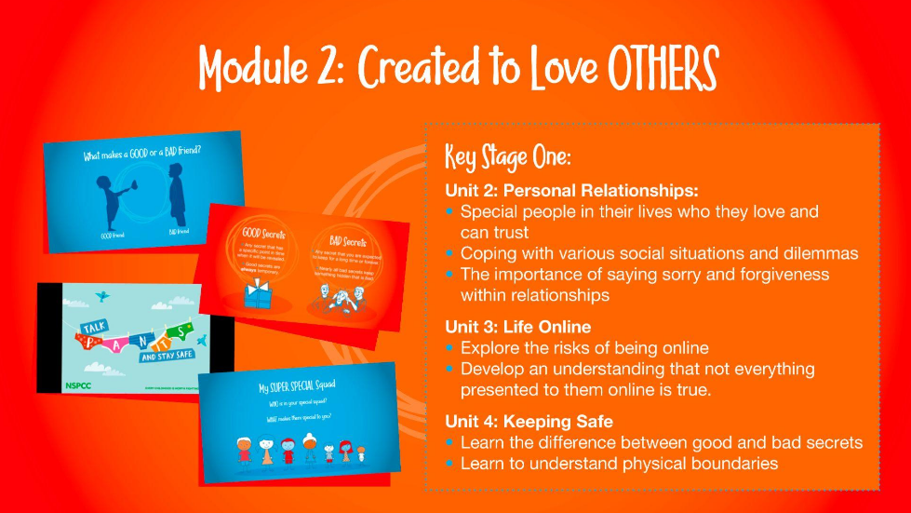
Notes:
Slide 16
Key Stage One – In Unit 2 ‘Personal Relationships’, children are taught to identify the Special People in their lives who they love and can trust, how to cope with various social situations and dilemmas, and the importance of saying sorry and asking for forgiveness within relationships.
In the Unit 3, ‘Life Online’, we explore the risks of being online by incorporating the Smartie the Penguin resources from Childnet, the difference between good and bad secrets, and teaching on physical boundaries (incorporating the PANTS resource the NSPCC).
While in Unit 4, ‘Keeping Safe’, Children also learn about the effects of harmful substances (including alcohol and tobacco), some basic First Aid and what makes a 999 emergency and what they should do if in an emergency situation.

Slide 20
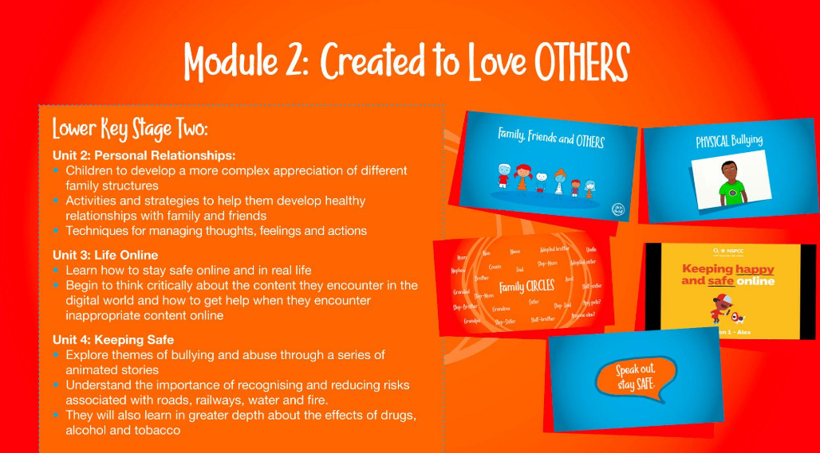
Notes:
Slide 17
Lower Key Stage Two – The Unit 2, ‘Personal Relationships’ sessions help children to develop a more complex appreciation of different family structures and there are activities and strategies to help them develop healthy relationships with family and friends; here, they are also taught simplified CBT techniques for managing thoughts, feelings and actions.
For Unit 3 ‘Life Online’, some NSPCC resources about online safety have been incorporated as part of the programme and children will learn to think critically about what they encounter online and know how to access help if they come across inappropriate material online.
Then in Unit 4 ‘Keeping Safe’, as well as teaching on bullying and abuse through a series of animated stories. Children will also learn in greater depth about the effects of drugs, alcohol and tobacco and how to make good choices concerning these as they get older.

Slide 21
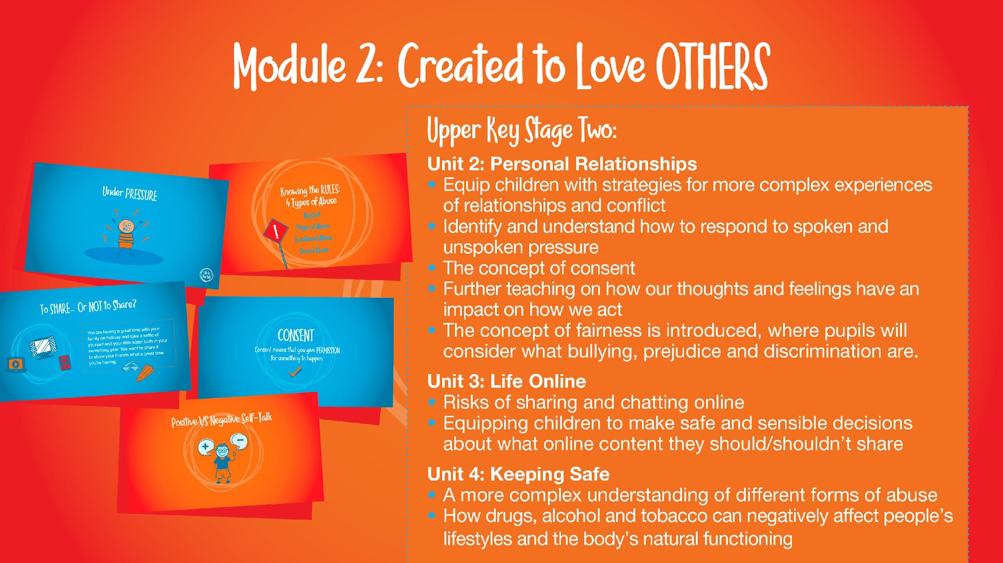
Notes:
Slide 18
Upper Key Stage Two – The sessions for UKS2 in Unit 2 ‘Personal Relationships’ sessions aim to equip children with strategies for more complex experiences of relationships and conflict; this includes sessions that help children to identify and understand how to respond to spoken and unspoken pressure, the concept of consent and some practical demonstrations of this, and further teaching on how our thoughts and feelings have an impact on how we act.
In Unit 3, Life Online, the programme explores the risks of sharing and chatting online at a level more appropriate to Years 5 and 6.
In Unit 4 ‘Keeping Safe’, children gain a more complex understanding of different forms of abuse. They also explore how drugs, alcohol and tobacco can negatively affect people’s lifestyles and the body’s natural functioning, discuss how to make good choices even in pressured situations, and teach essential First Aid such as DR ABC and the recovery position.

Slide 22
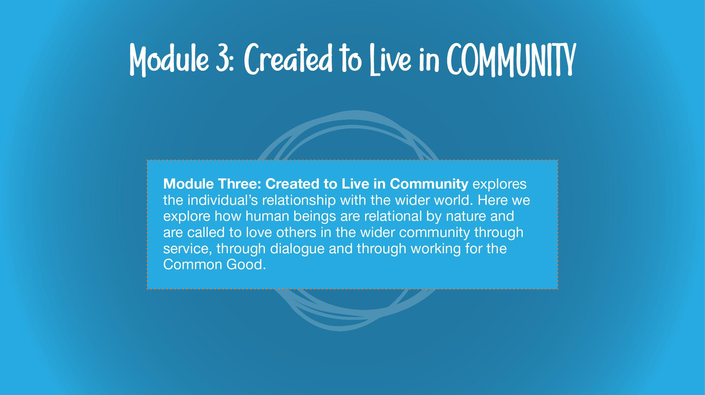
Notes:
Module Three in detail (2 mins)
Slide 20
Module Three: Created to Live in Community
Using the text on screen, explain that Module Three: Created to Live in Community explores the individual’s relationship with the wider world. Here we explore how human beings are relational by nature and are called to love others in the wider community through service, through dialogue and through working for the Common Good.

Slide 23
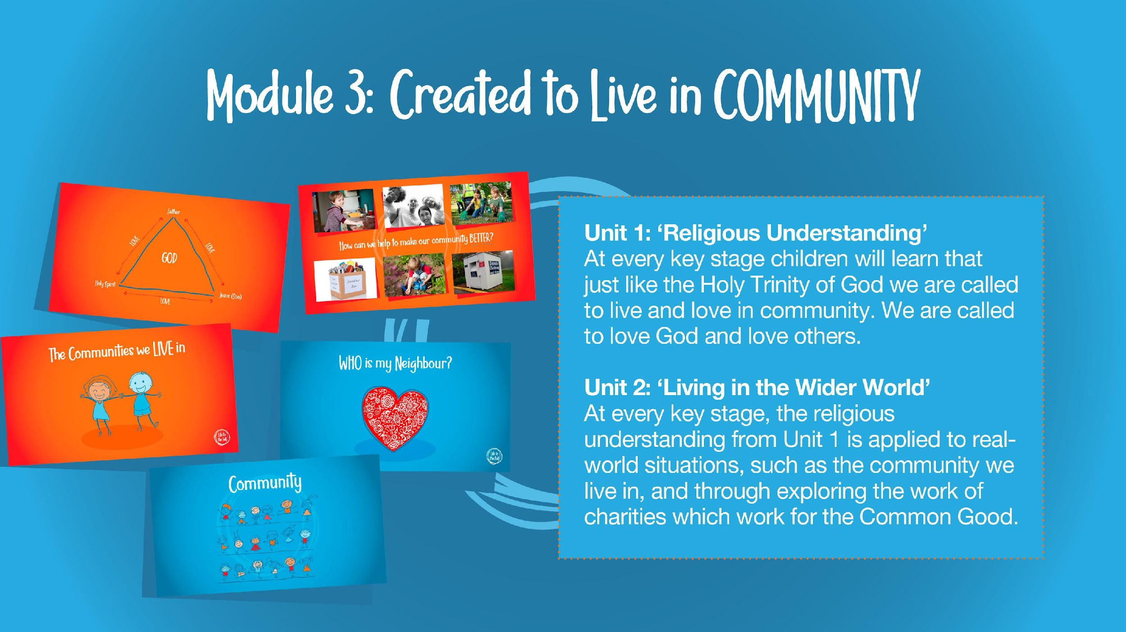
Notes:
Slide 21
In the first Unit, Religious Understanding, the story sessions help children to develop a concept of the Trinity.
Subsequent Sessions for EYFS, KS1, LKS2, UKS2
In subsequent sessions, this religious understanding is applied to real-world situations, such as the community we live in, and through exploring the work of charities which work for the Common Good.

Slide 24
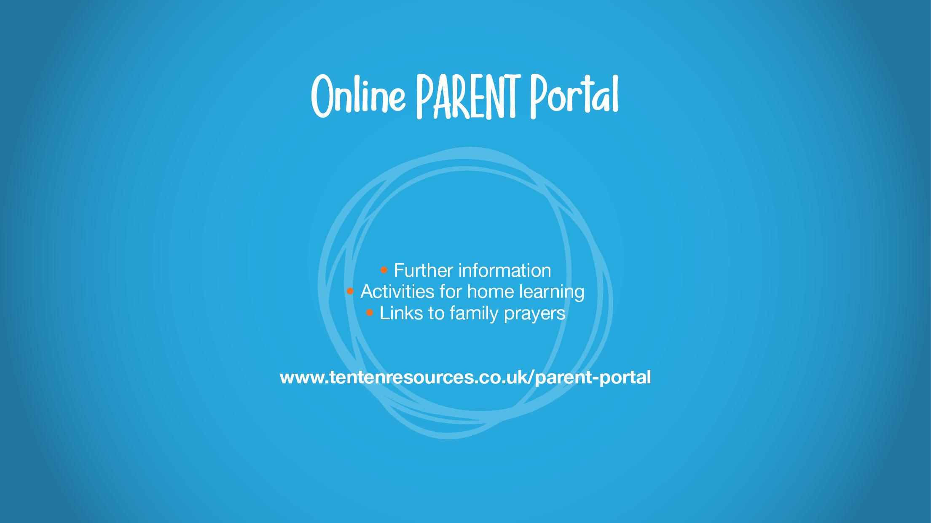
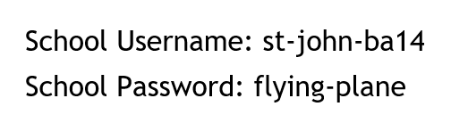
Notes:
Online Parent Portal (4 mins)
Slide 25
Explain to parents that Ten Ten Resource have developed an Online Parent Portal as part of the programme where further information about the programme resources can be accessed, activities for home learning and links to family prayers relating to the programme.
Signpost to parents how they can access the site using the school’s unique username and password.

